Slide 1
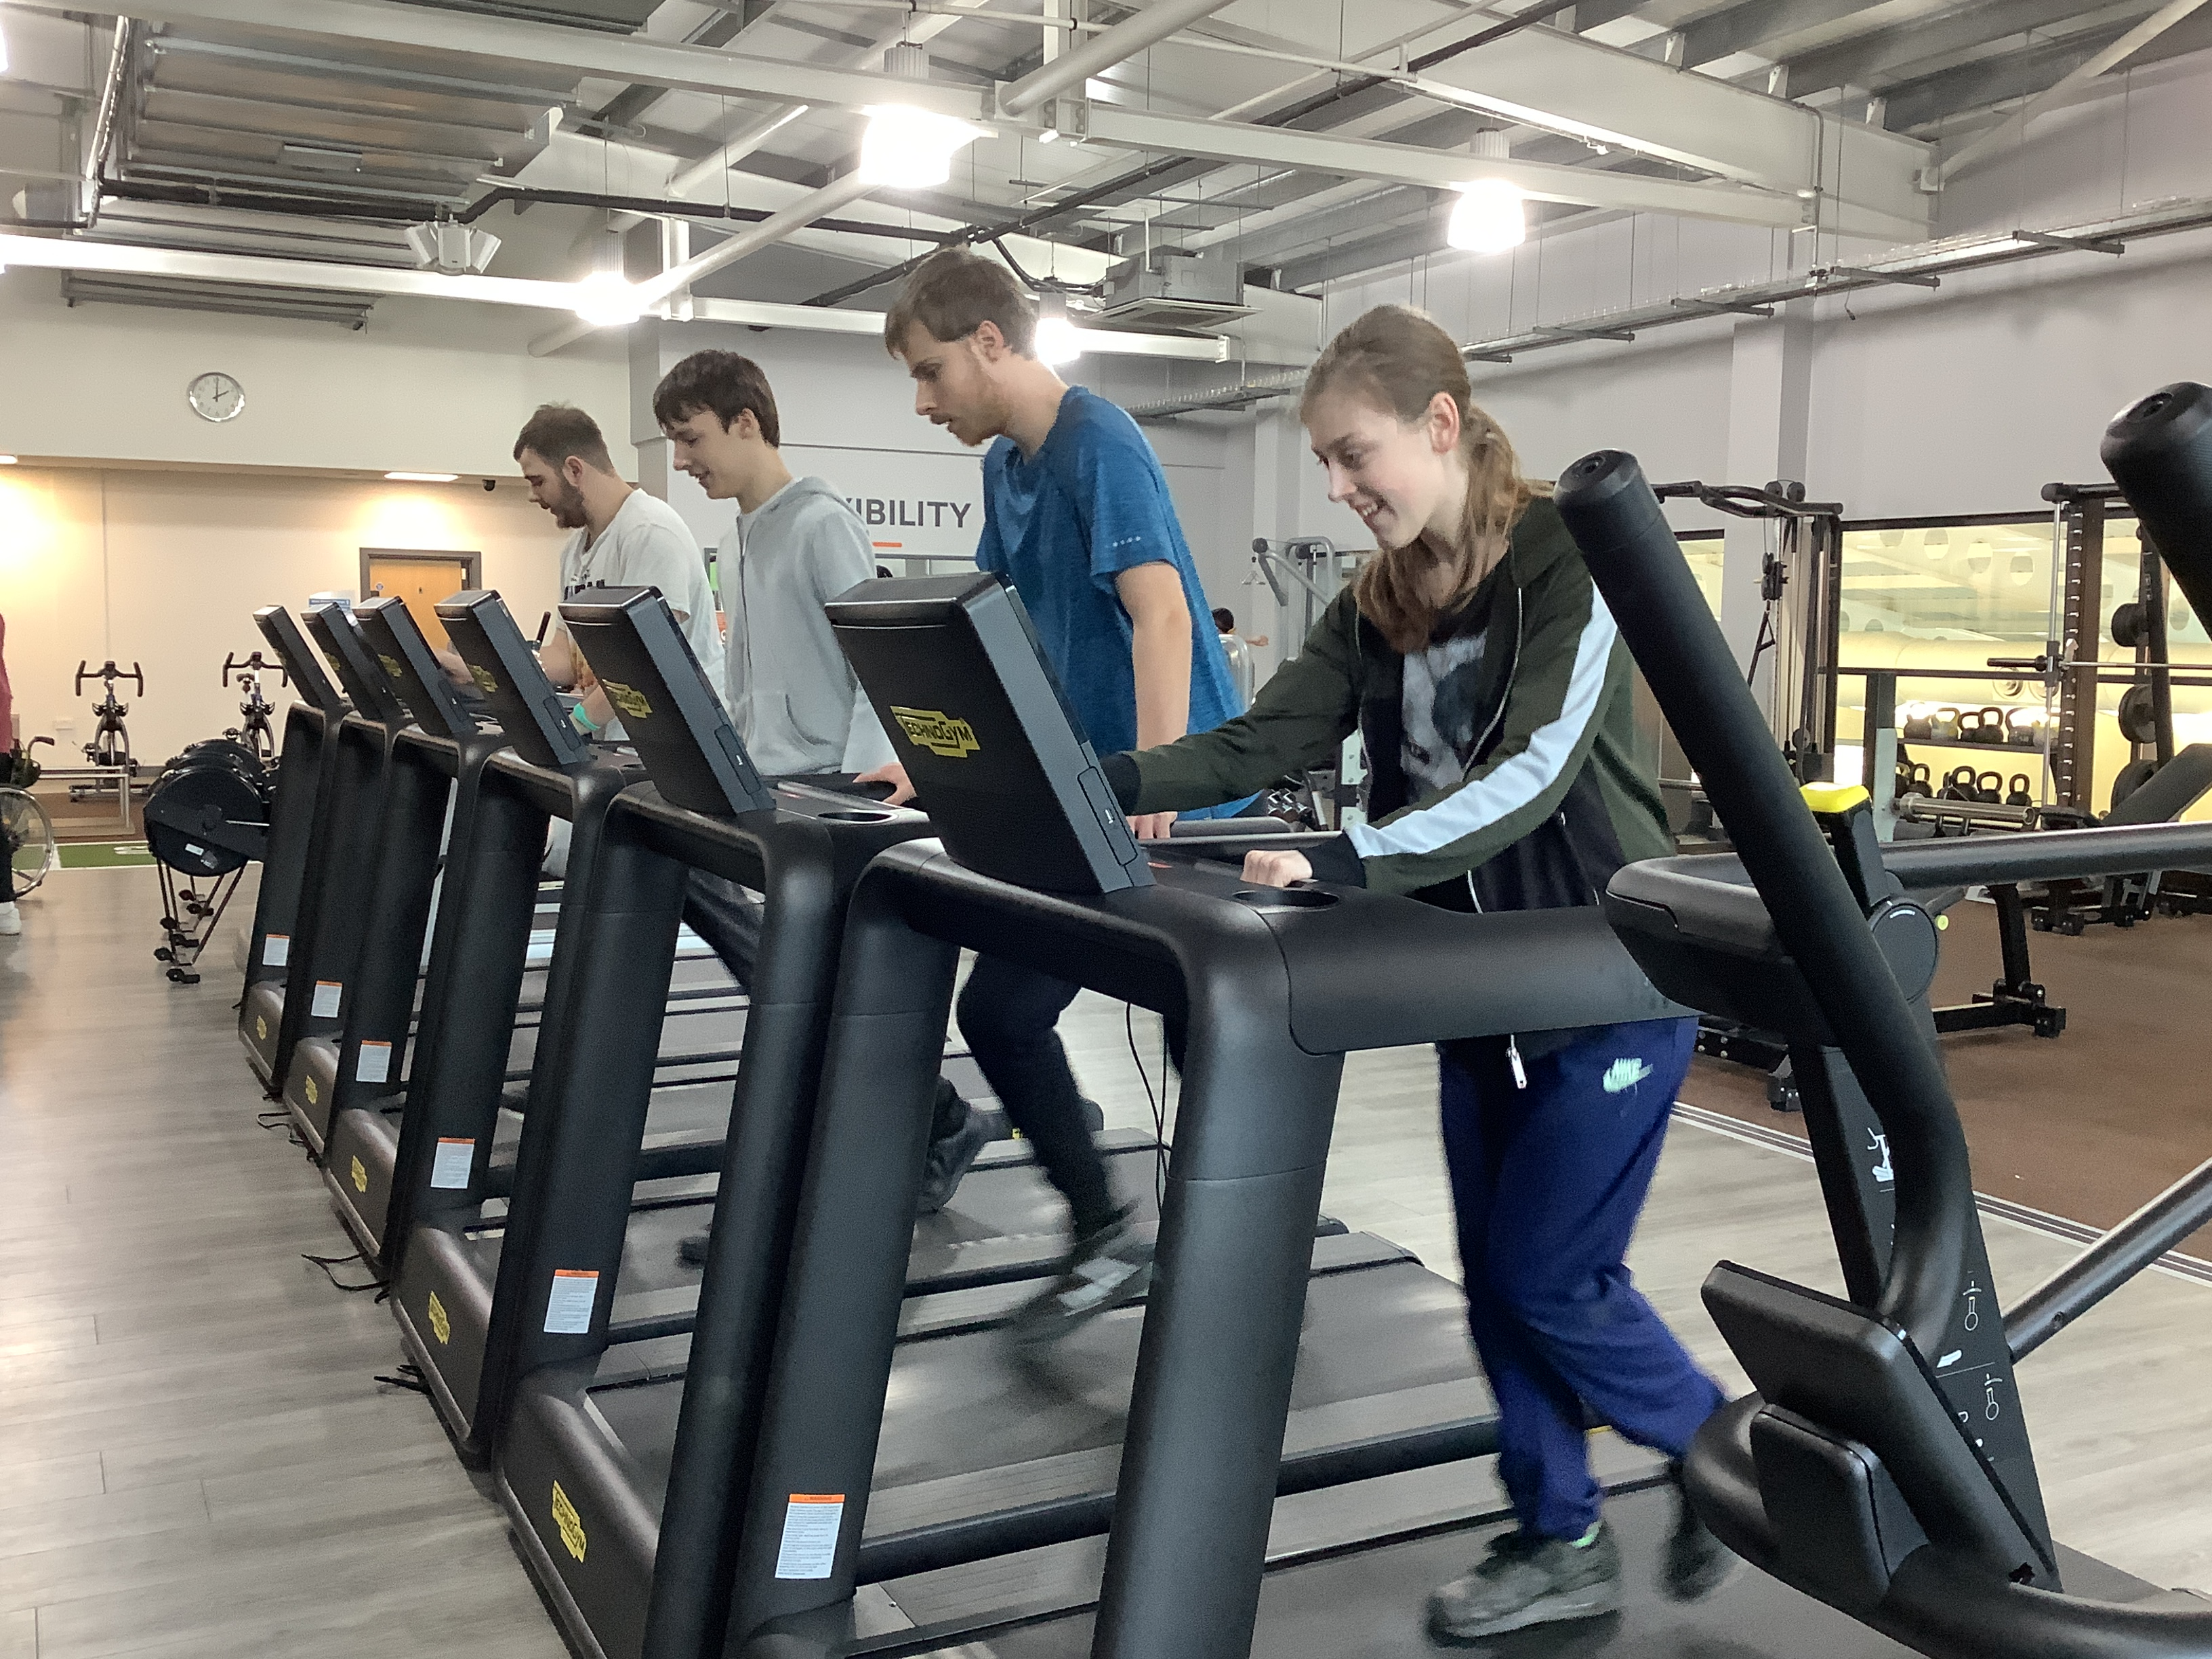
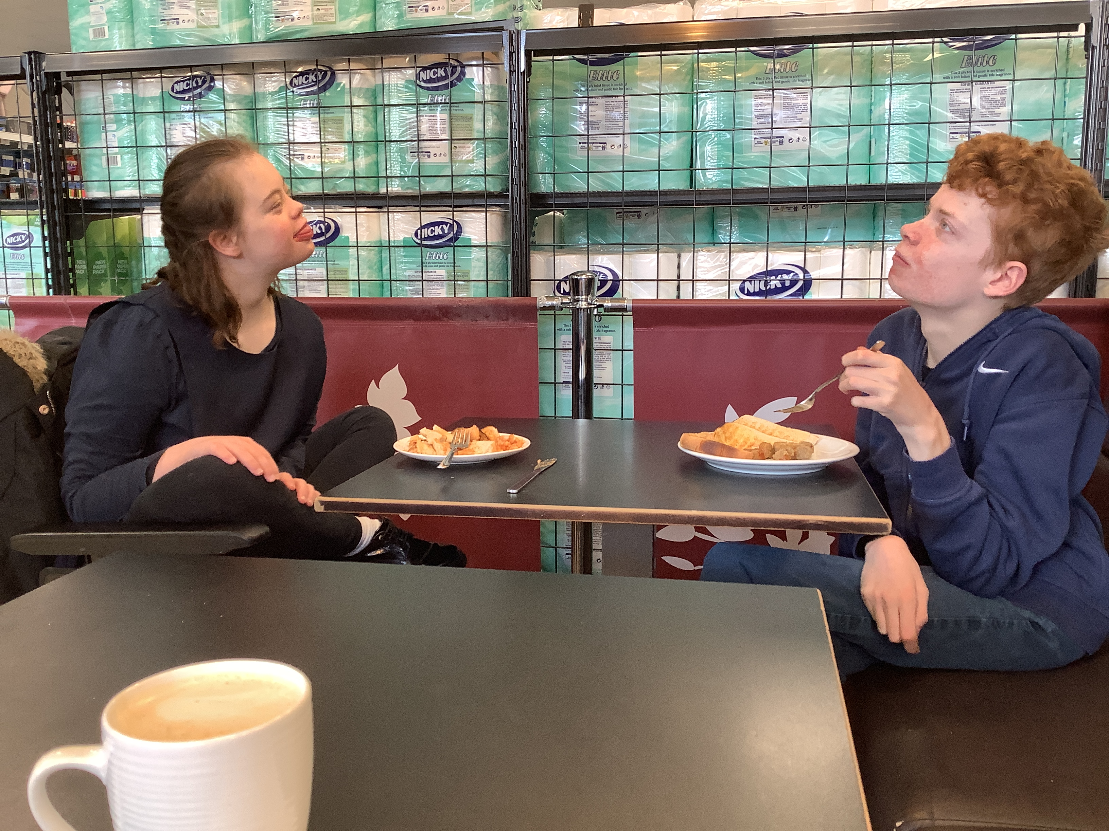
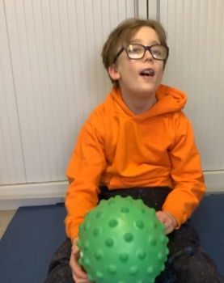
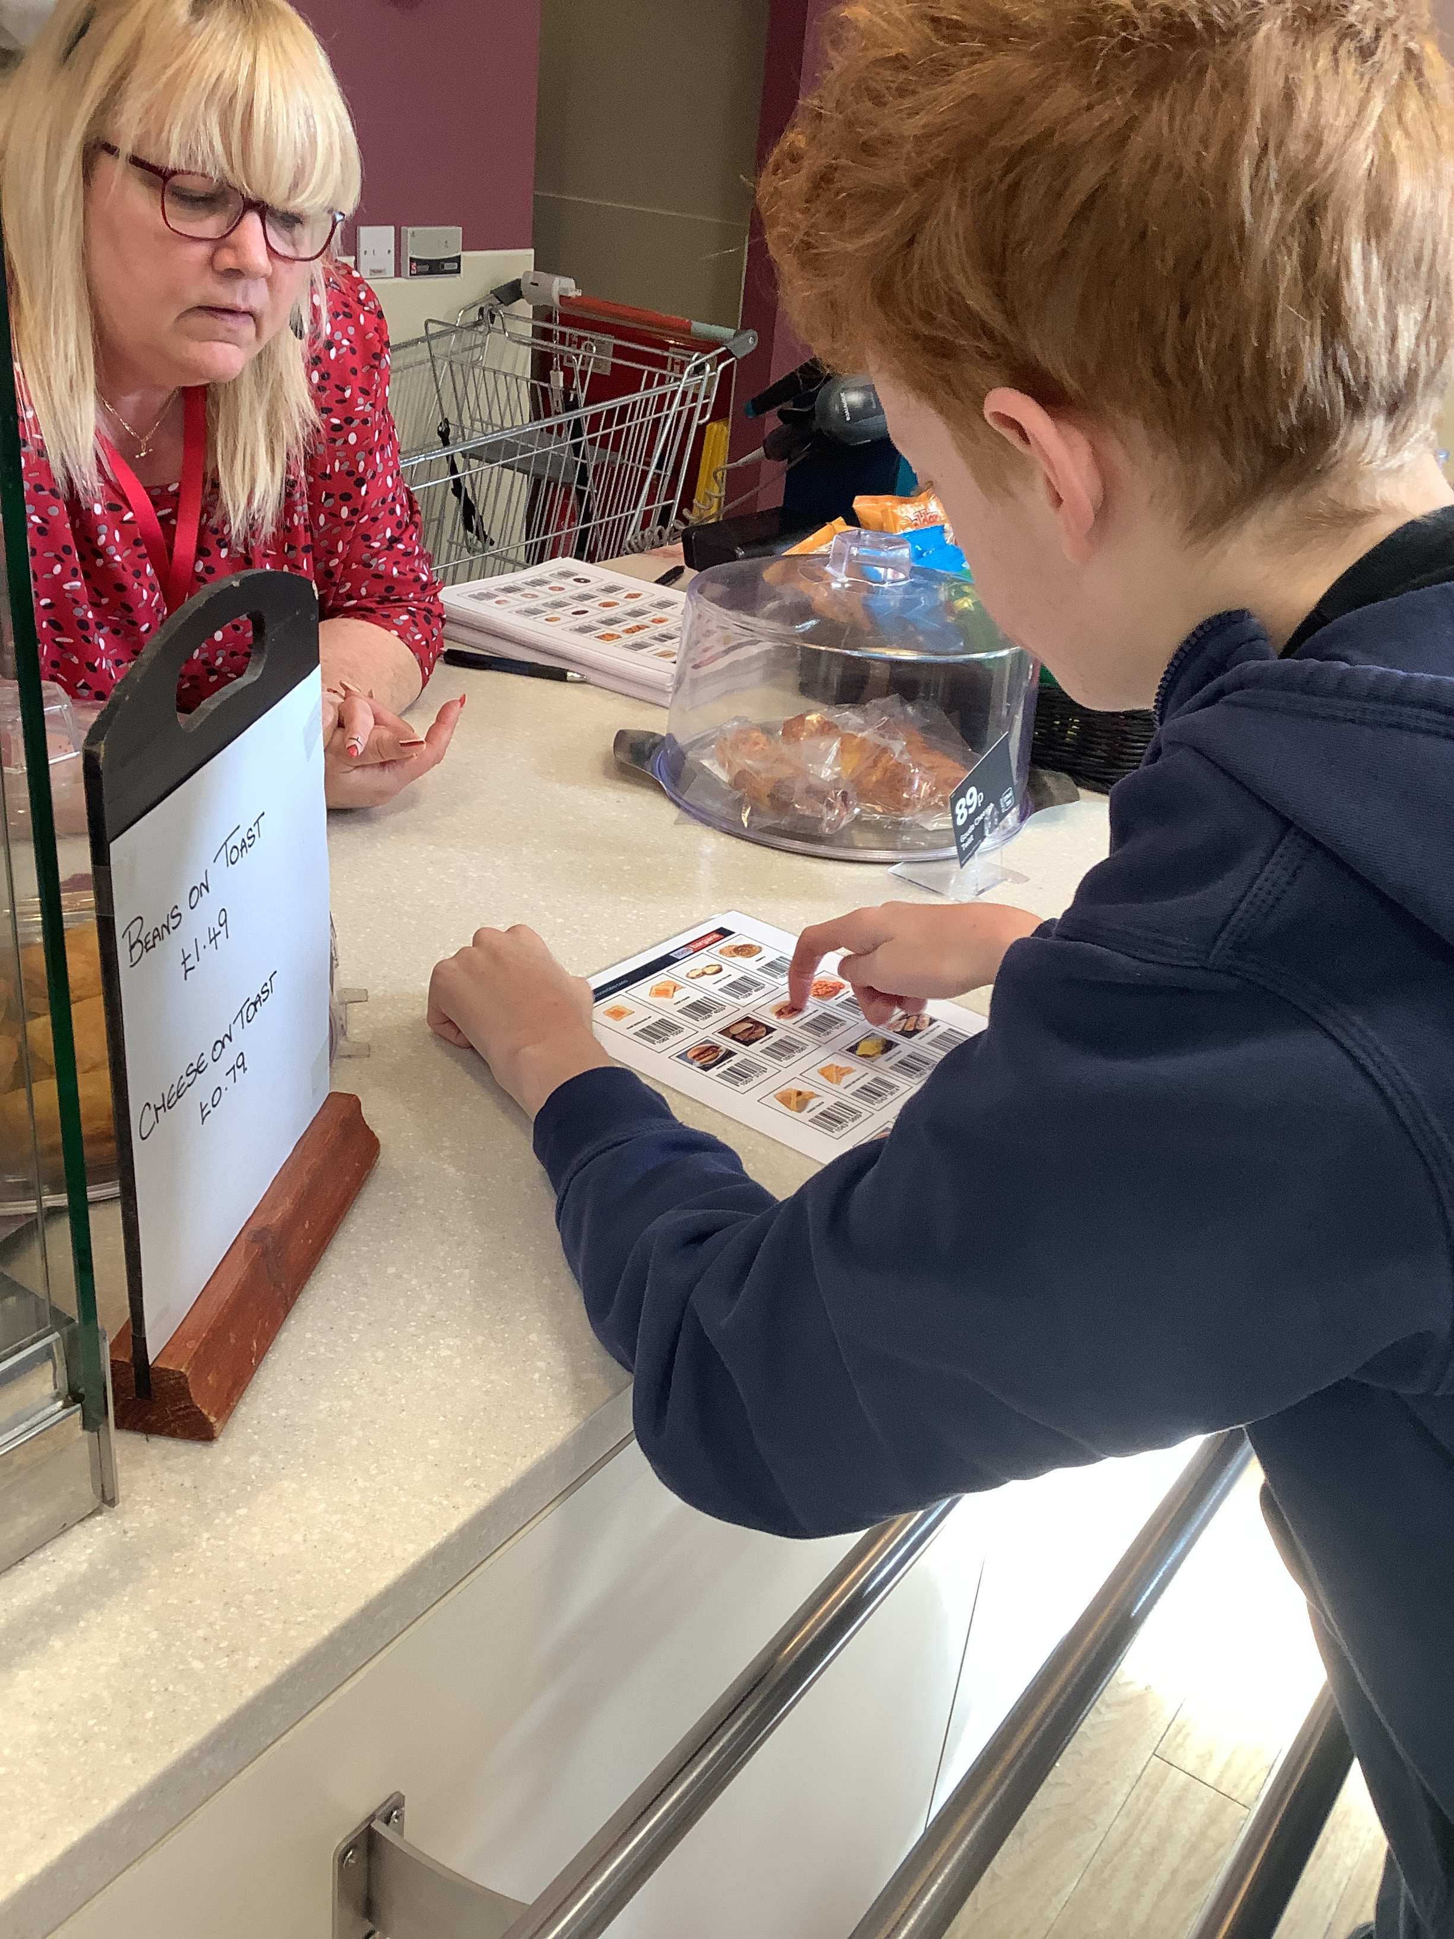
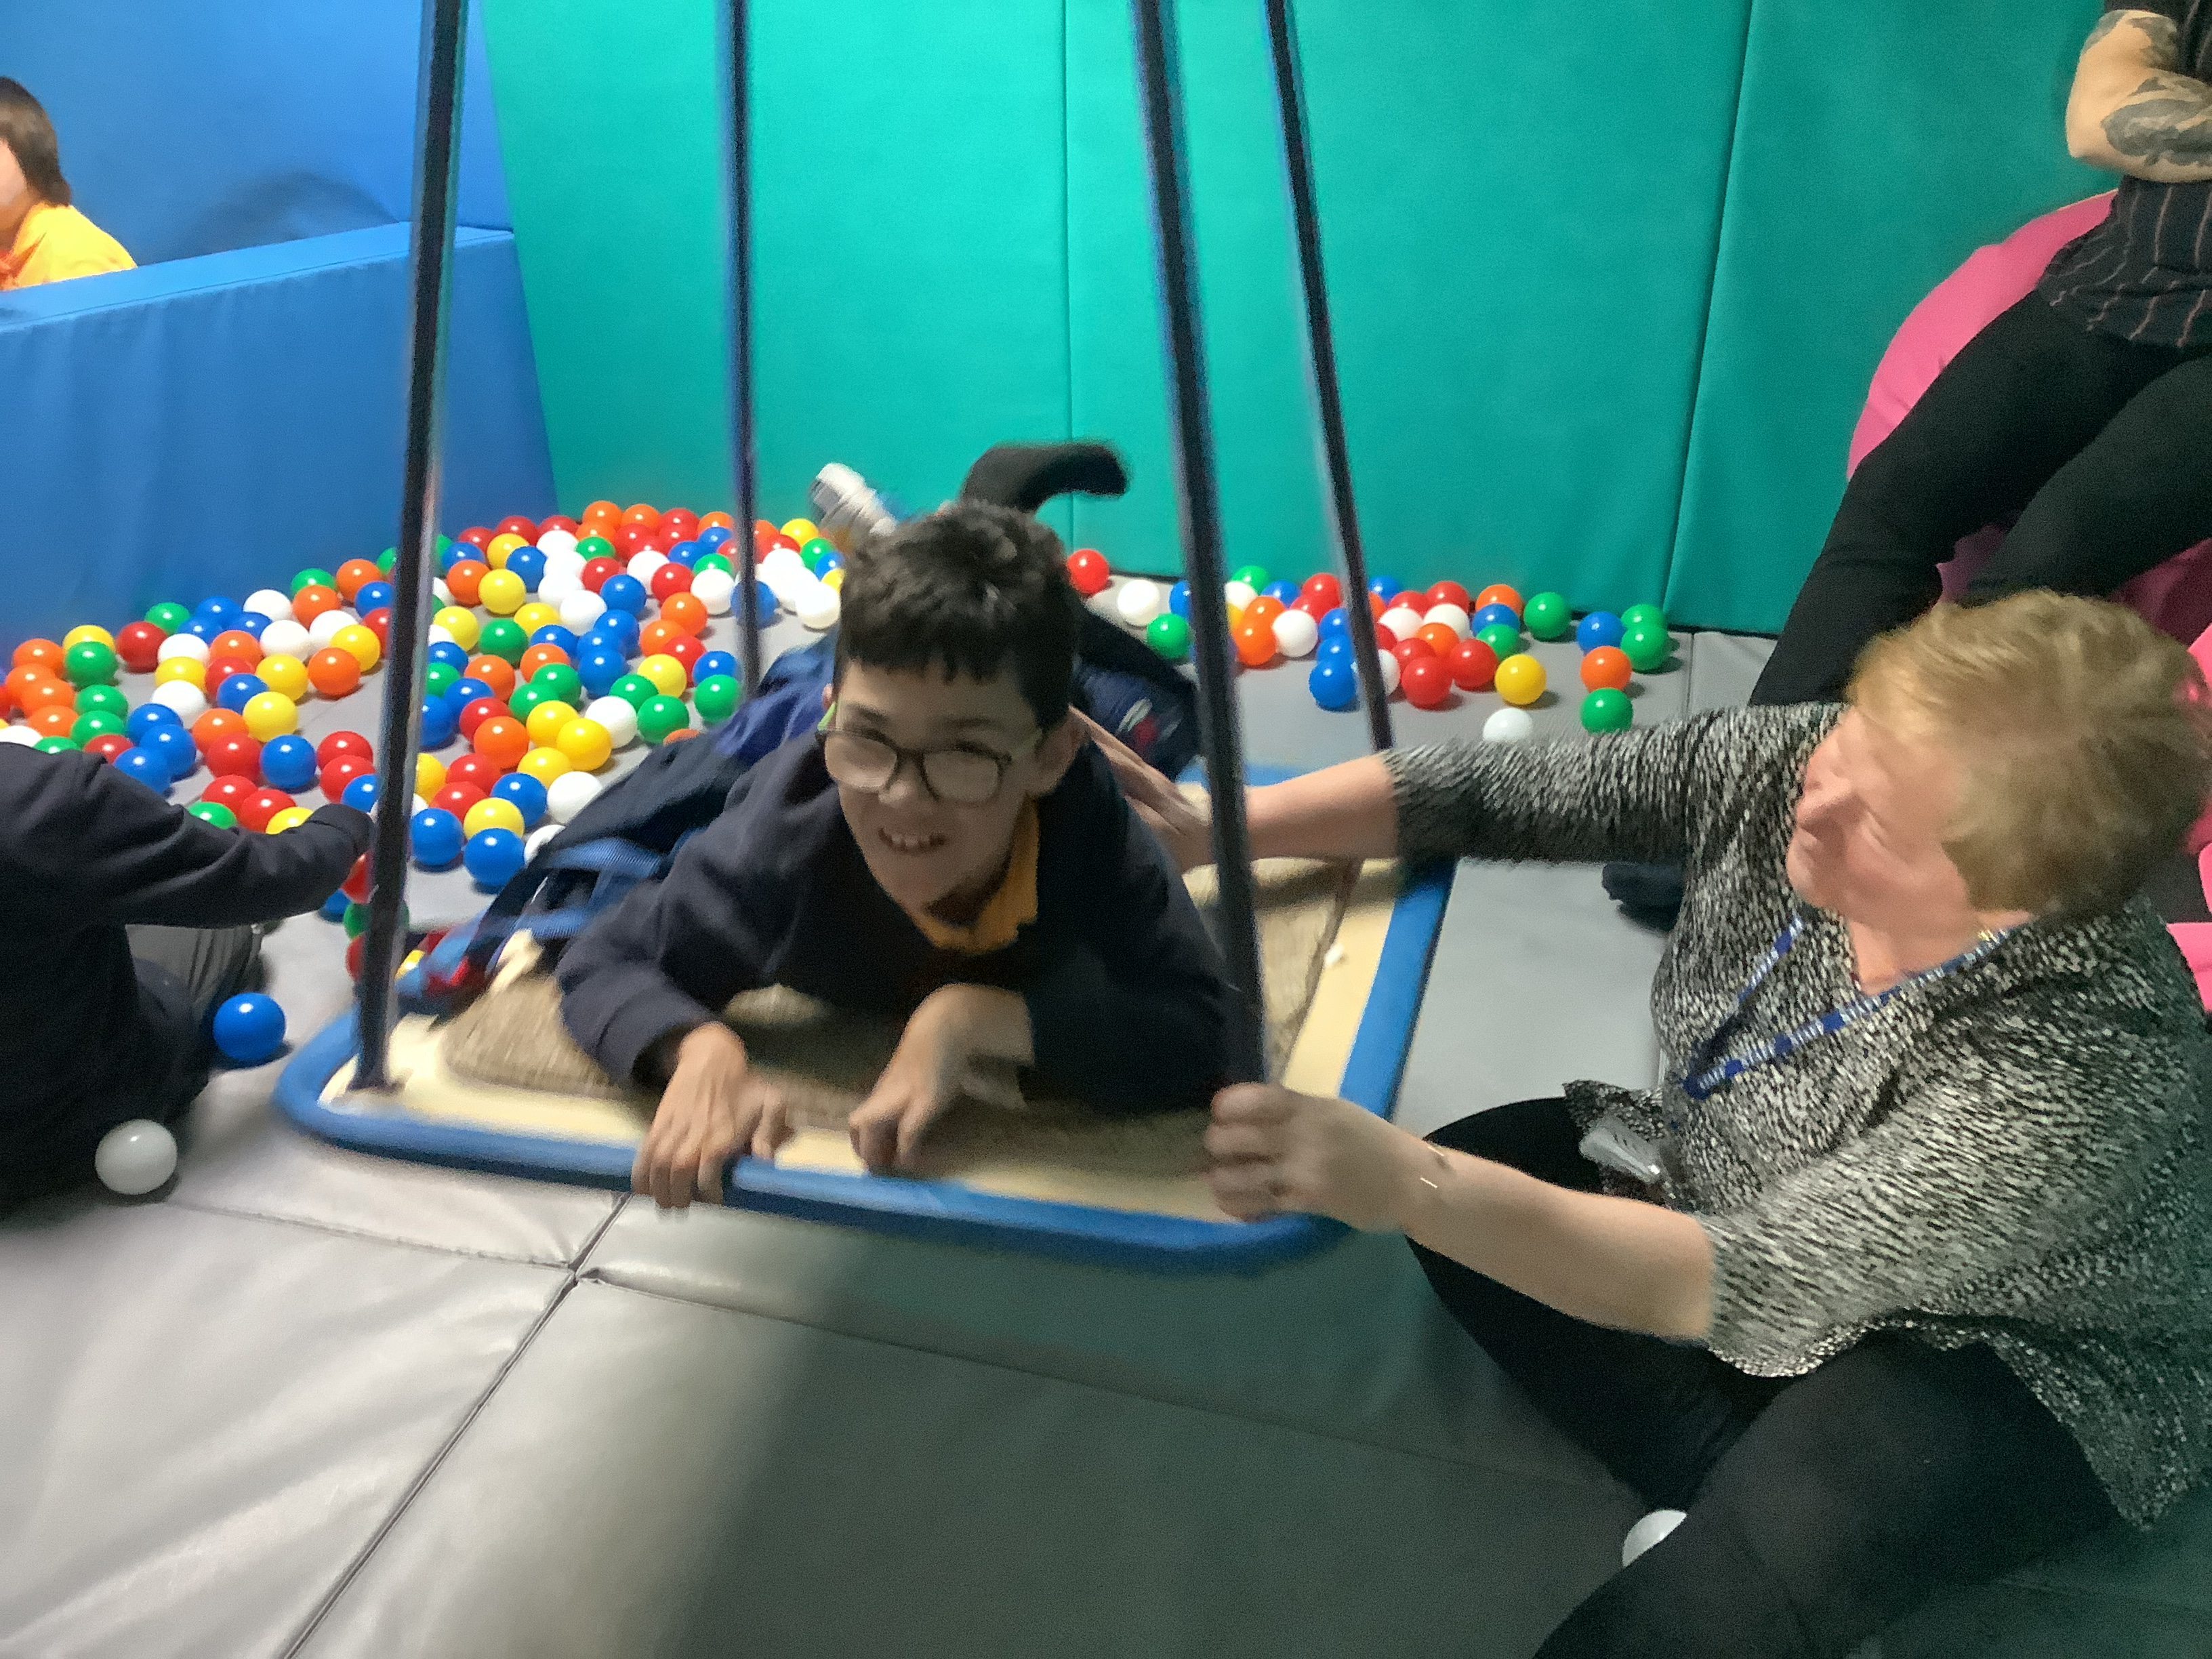
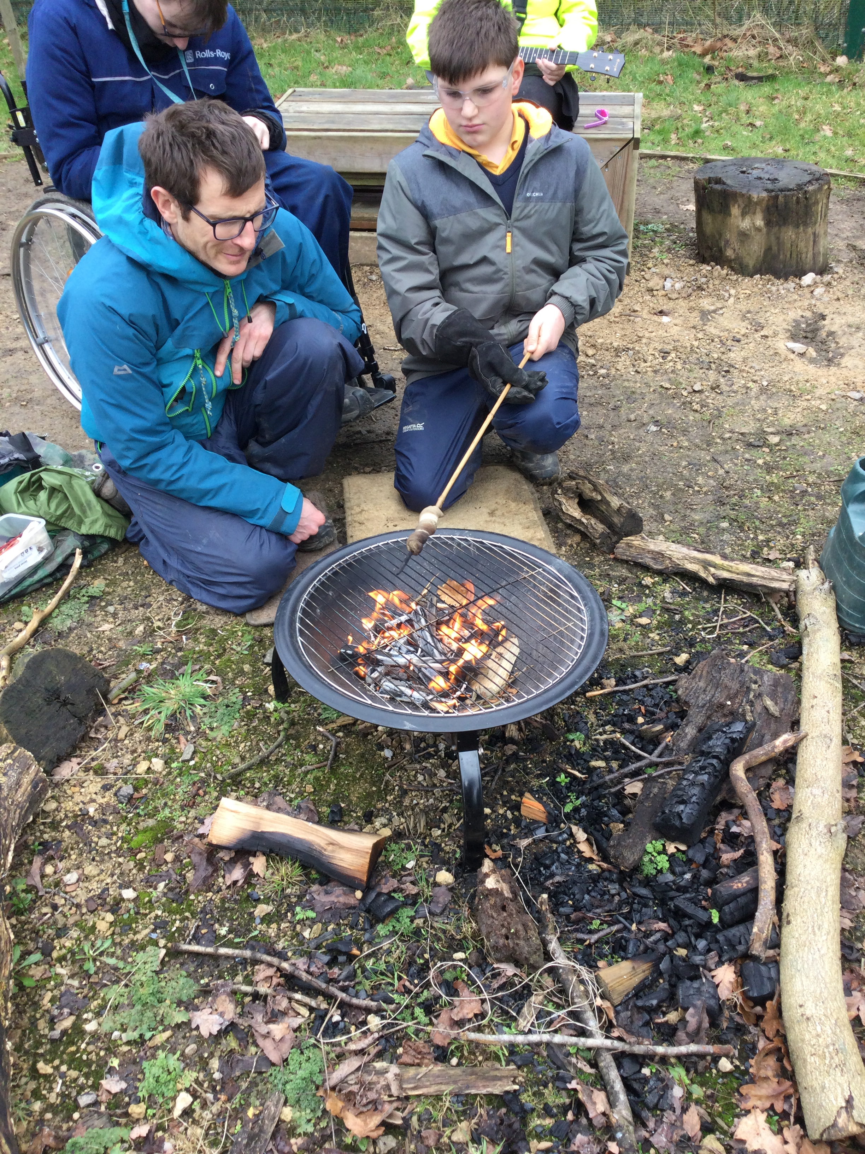
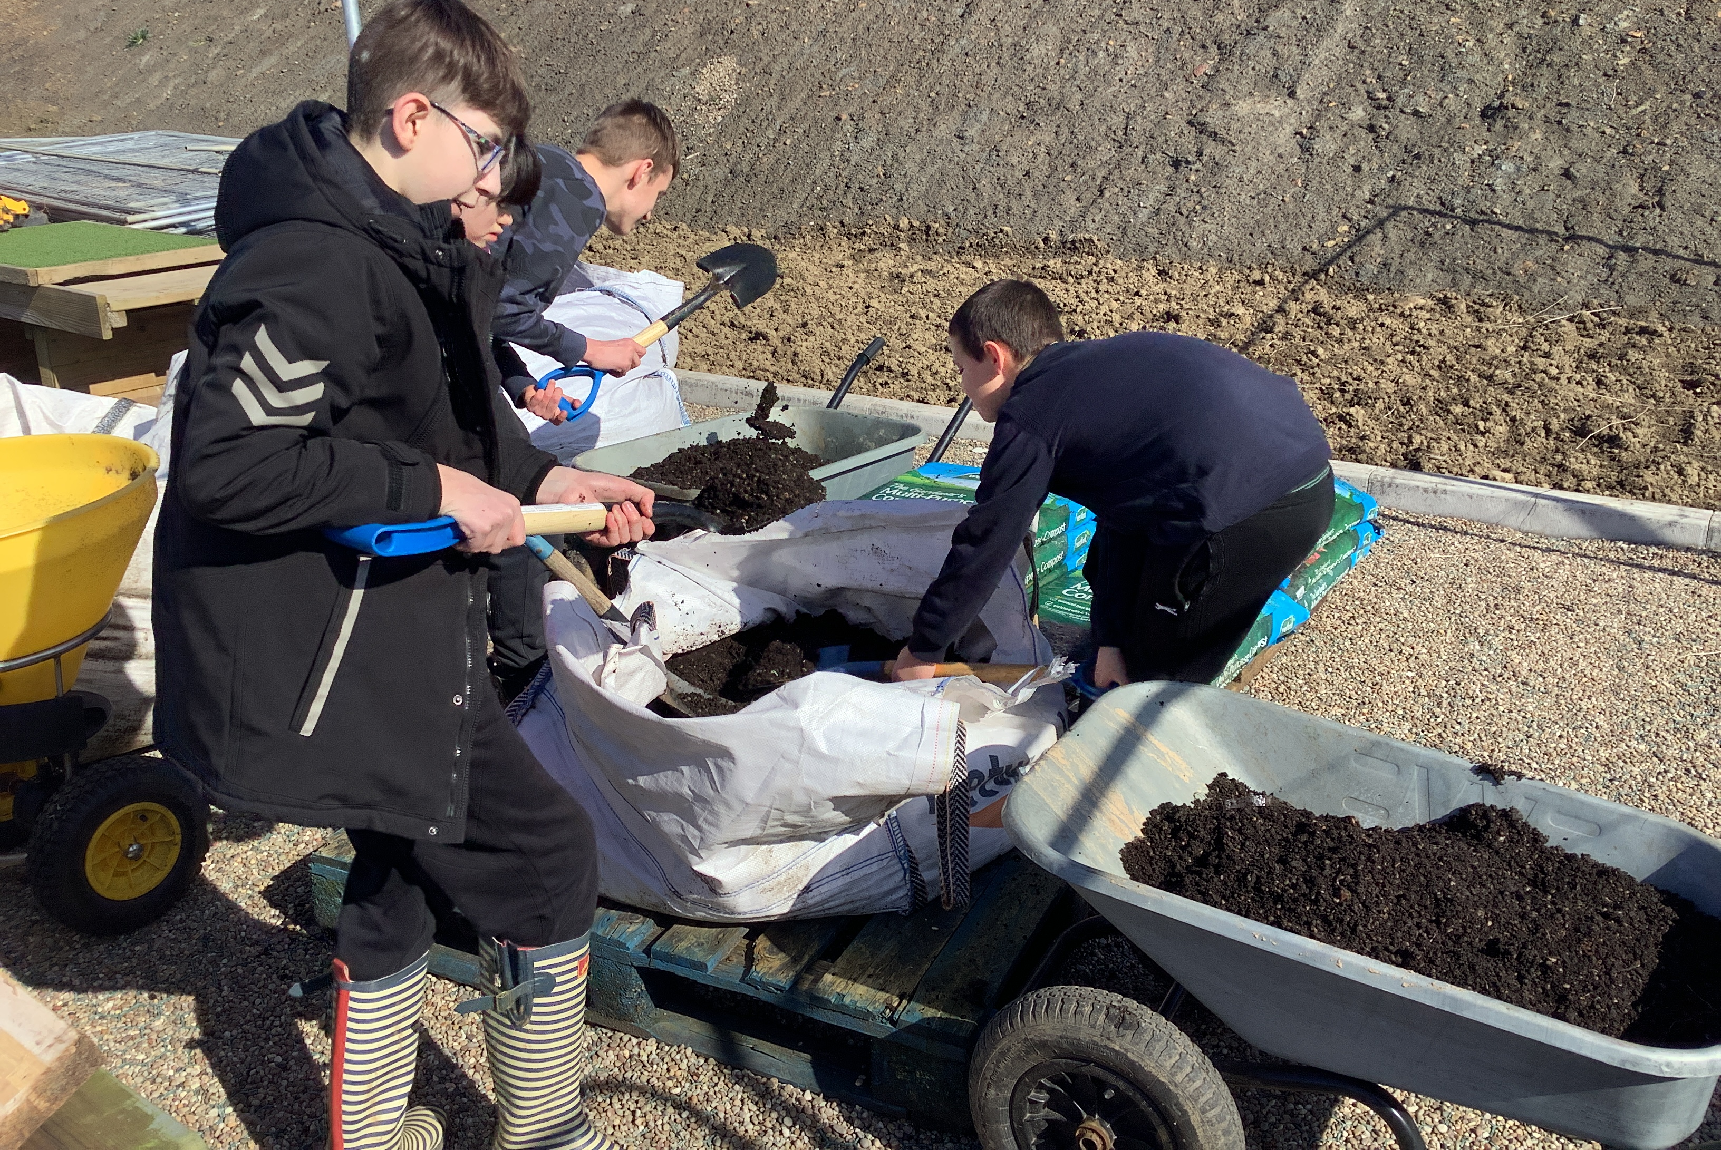
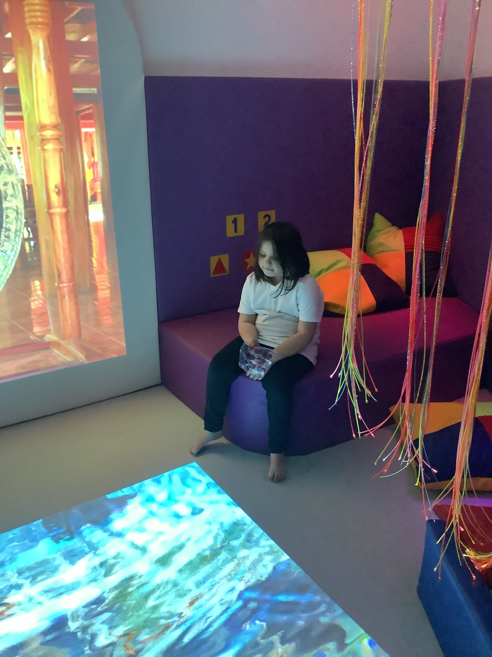
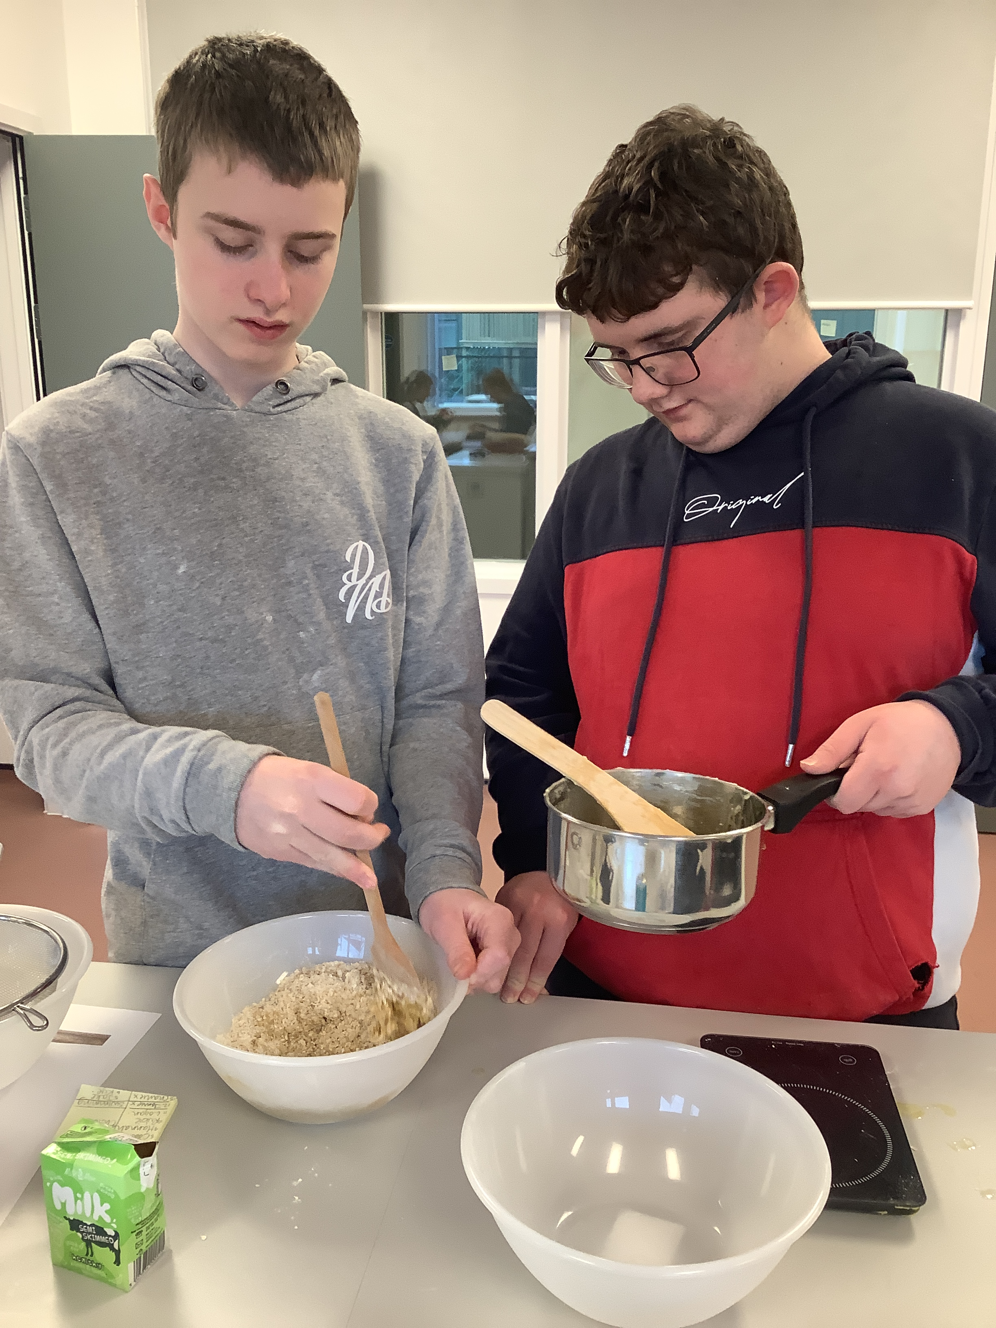
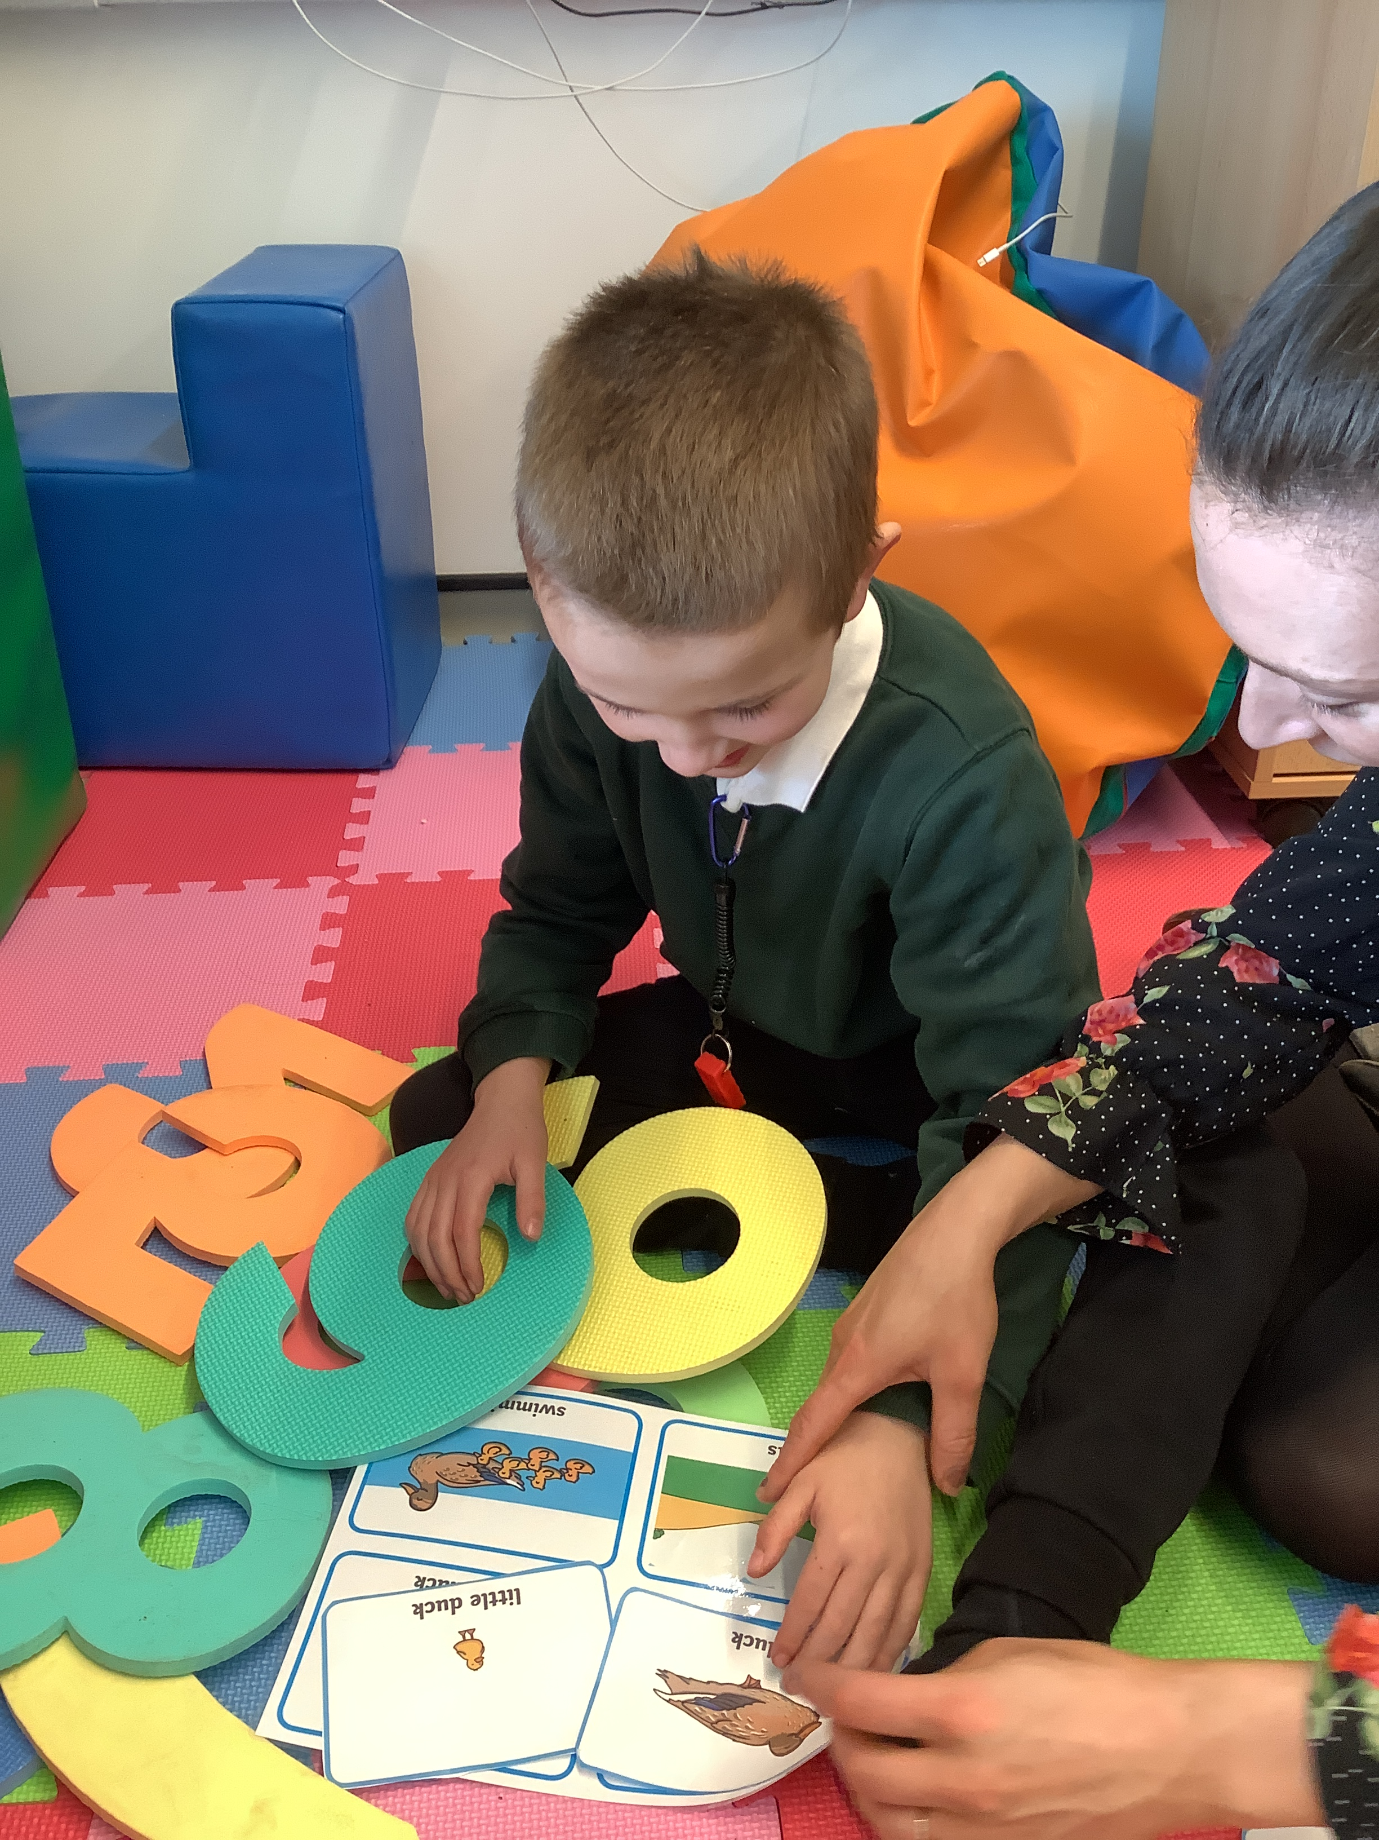

Slide 2
School Context
We are an all-through (2-19) generic special school, accommodating a wide range of pupils with SEND.
We have small classes of between 6 and 15 pupils, each with a teacher and between 1 and 4 teaching assistants.
Classes are divided into Early Years, Primary, Secondary and Post-14 departments.
Classes are grouped by a combination of need, age and learning style
Our pupils have severe, complex and profound learning difficulties, with many of them on the autistic spectrum. We also support pupils with additional medical needs, physical disabilities and more.
We are a happy, caring community focused on helping our pupils to learn, problem solve, develop interests, independence and social skills and grow to discover their place in the adult world, through an individualised curriculum.

Slide 3
Our Vision
We recognise the challenges our pupils face and the need for them to understand respect, develop resilience and be ambitious, aiming for the moon and falling amongst the stars. All of our pupils are capable of contributing meaningfully to society and in their local community there are increasing opportunities to do so; our role is to facilitate this by working closely with stakeholders to effectively equip pupils with the necessary knowledge and skills for their next stage.
Alfreton Park School’s vision is that pupils, staff, families and the local community collectively learn and progress together in a stimulating, safe and supportive environment, reaching their maximum potential in all aspects of their life.
We aim to promote independence at every given opportunity
in a safe and nurturing environment.

Slide 4
Our Values
We’re Caring Pupils experience a wide range of differences in ways appropriate to their level of understanding They develop an awareness that many people have a range of different views and beliefs Equally, they feel able to be themselves and feel respected by others Being caring is the role of the whole school community and supporting adults strive to educate the wider community on the wonderful qualities our pupils hold, and ensure they receive the respect and care that they deserve We expect that members of our school community have a caring attitude towards one another We insist on mutual respect as a minimum. | We’re Brave Being brave represents being proud of who you are, trying new things, feeling secure in communicating with new people, visiting unfamiliar places, being part of new experiences and feeling confident to ask for help It is the role of supporting school community members to facilitate this, equipping pupils with the knowledge, skills and support mechanisms to feel confident to do these things as they grow and develop Our pupils, again just like many, many other children growing into young adults, face challenges and will continue to do so in adult life. It is the school community’s responsibility to prepare them and help them to cope with this in the best way that works for them (and in our context, this does not mean facing it alone!) Pupils develop strategies to help cope with unforeseen change, or when their feelings overwhelm them Being brave for supporting adults in our school community means allowing our pupils to take risks, exposing them to new opportunities and not underestimating their capabilities. | We Aim High We want our pupils to maintain their ambition throughout life. The school community should not settle for less than they are capable of Aiming high links to physical independence, forming relationships, being able to communicate effectively and successfully, accessing their local and wider community It is the role of the wider school community to promote pupils’ strengths and facilitate their ambitions in a way that is appropriate for each individual Pupils aim to find out ‘who’ they are – developing interests and hobbies Pupils form relationships, attain employment and access the wider community, feeling a sense of belonging They foster a love of learning that they take with them beyond school into adulthood

Slide 5
APS Curriculum
We subscribe to a pupil-centred philosophy of education, and they are at the heart of everything we do.

Slide 6
Teaching – how pupils learn
We use our knowledge of the needs of our pupils to present learning opportunities in ways that are accessible and engaging
We tailor our approach to suit the strengths and interests of our pupils, through the implementation of a wide range of specialist strategies to deliver personalised provision
We place particular importance on the development and exercise of independence not just as a goal, but as a method, and feel that our pupils learn best when they are empowered to think, say and do things for themselves wherever possible

Slide 7
Assessment – how we measure success
We set highly motivating and appropriately challenging targets, focusing on the development of the whole child.
We evaluate progress by returning to earlier targets and plans to review their impact and the progress pupils have made.
Where we find a winning formula, we aim to repeat our successes, and where we encounter challenges, we aim to learn and improve – using our assessments to shape future learning and next steps.
We recognise that progress is not just about assessment data, and we value the full range of pupils’ efforts and achievements in the way that we track their holistic growth.
We use the Engagement Steps to assess our pre- and semi-formal learners, and the Progression Steps to assess the progress our formal learners make.
Individual Learning Plan (ILP) targets are derived from pupils’ EHCPs and are a priority for all learners. These are reviewed and updated targets set every full term.

Slide 8
Curriculum Key Staff
Headteacher
Josie O’Donnell
Curriculum Lead
Deputy Headteacher
(Emma Durham – mat leave)
Charlotte Young (Acting)
Curriculum Lead
Marie McCuaig
Assistant Head
Physical & Sensory Lead
EYFS
Clare Charlesworth
Acting Assistant Head
Communication & Interaction Lead
Attention Autism
Amy Naylor
Post-14 Lead
Careers Lead
Accreditation
Clare Charlesworth
(Currently Acting Assistant Head)
Katie Turner
Social, Emotional & Mental Health Lead/Cognition & Learning Lead
PSHE/RSHE
Katy Morley
Sensory Integration
Victoria Sheldon
Attachment Specialist
Ruth Woodhouse
Music
Annabelle Towndrow
Attention Autism
Ed Acorns
Music
TA
Jeannette/ Mary
Work Experience TAs
MOVE & Physical Link Worker
Donna Speight
Wendy Toft, Sam Butlin, Richard Simpson Forest Schools
Matt Clemens, Alison Drake Horticulture
Lynne Radlett & Treg Marsh
Thrive Practitioners
Treg Marsh
Art Mentor
TA
Tracy Cross
Communication
TA

Slide 9
Interventions and Learning Approaches
Blank Levels
http://www.elklan.co.uk/
Read, Write, Inc.
http://www.ruthmiskin.com/
Attention Autism
http://www.ginadavies.co.uk/
Horticulture
Therapeutic Arts
Sherborne
http://www.sherbornemovementuk.org/
MOVE
https://www.enhamtrust.org.uk/what-is-move/
Intensive Interaction
http://www.intensiveinteraction.org/
Sound Bath
https://www.healthline.com/health/sound-bath
Thrive
http://thriveapproach.com/
Open Orchestra
http://www.openorchestras.org/
Lego Therapy
https://therapyfocus.org.au/on-the-blog/what-is-lego-therapy/
Halliwick
https://www.halliwick.org/
Forest Schools
http://www.forestschoolassociation.org/

Slide 10
Therapies
At Alfreton Park we adhere to the SEND Code of Practice (2020), prioritising our pupils’ communication, cognition, social and emotional development and physical and sensory development above all else. We have a fantastic hydrotherapy pool which is timetabled to prioritise those pupils most in need. We also have service level agreements with both speech and language and occupational health providers to enable us to follow the best advice and support for our pupils.
Pupils benefit from weekly visits from Nicki Lees, Speech & Language Therapist (SaLT). Nicki is experienced in Alternative, Augmentative Communication (AAC) and has a wonderful relationship with our pupils.
We also have fortnightly visits from a Sensory Integration Accredited Occupational Therapist (SI OT) to support pupils with their sensory needs, enabling staff to follow her guidance and follow the plans she provides to implement sensory diets several times daily as needed for each individual.
Physiotherapists visit school most weeks along with the Occupational Health team to work with pupils on their caseload.

Slide 11
Hydrotherapy Pool

Slide 12
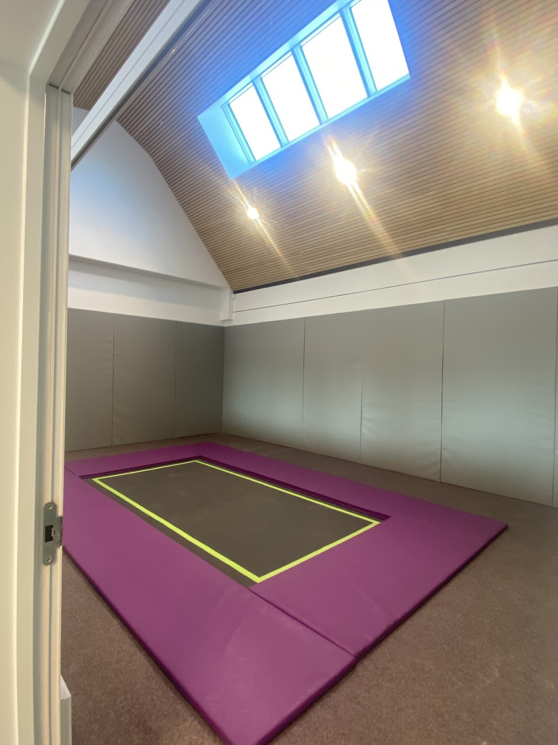
Rebound Therapy Room

Slide 13
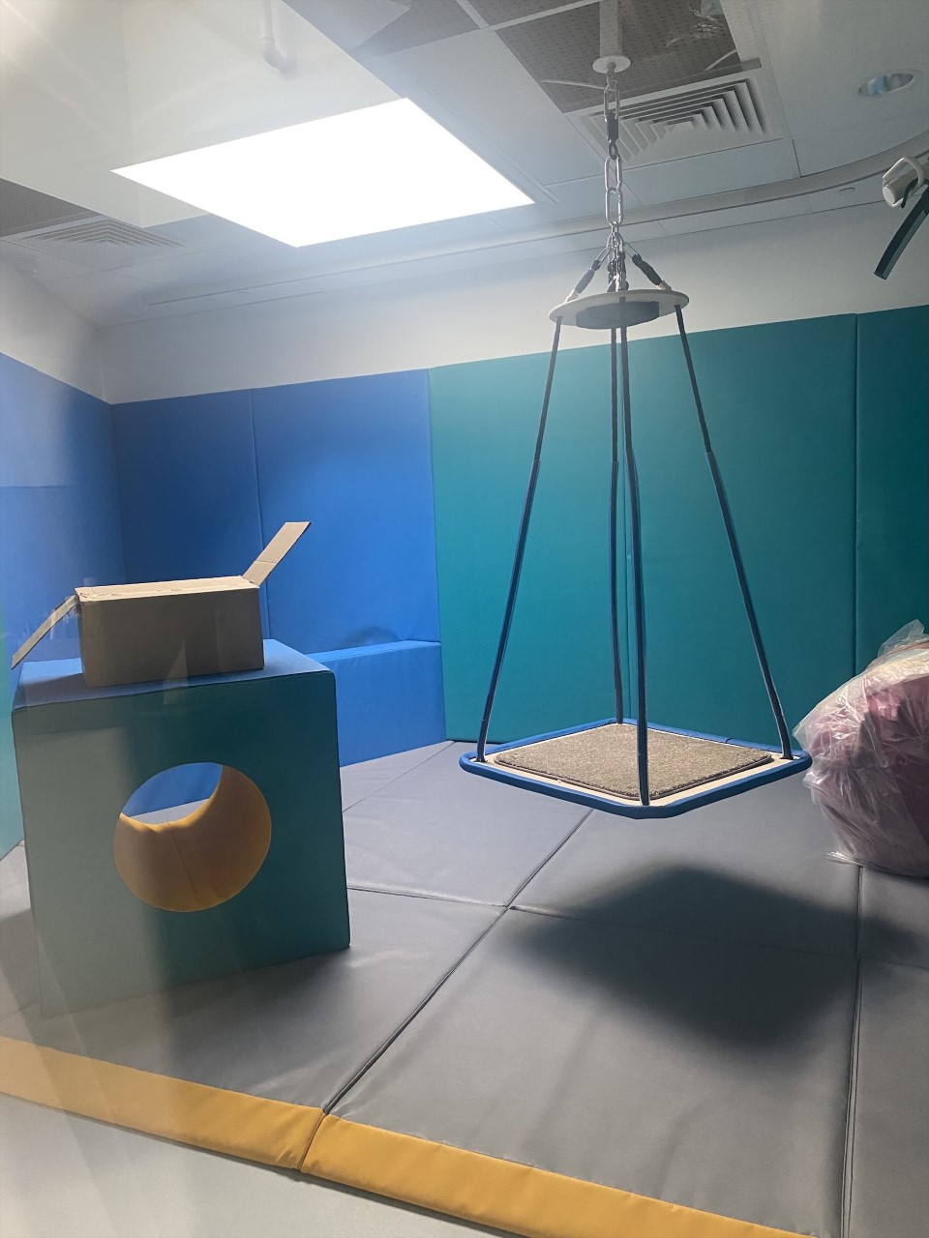
Sensory Integration Room

Slide 15
Designated Safeguarding Leads
(Mat leave)

Slide 16
Core Safeguarding Team
(Mat leave)

Slide 17
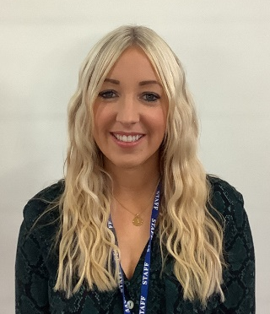
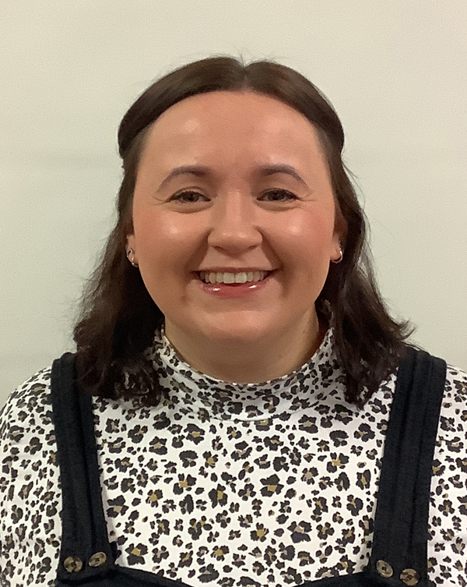
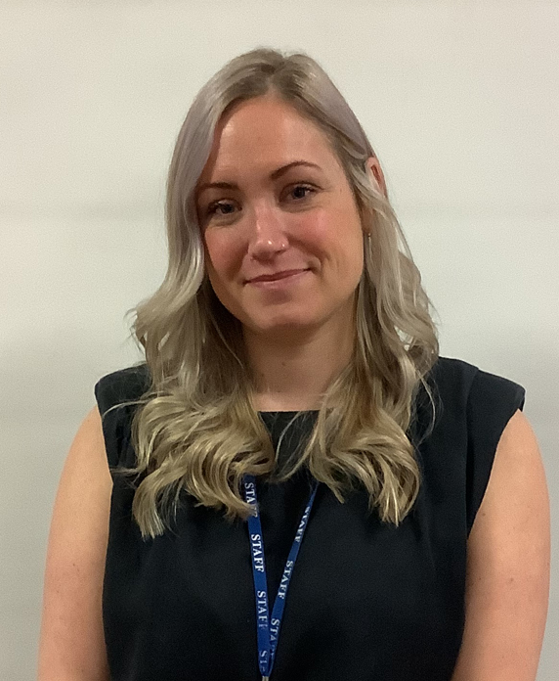
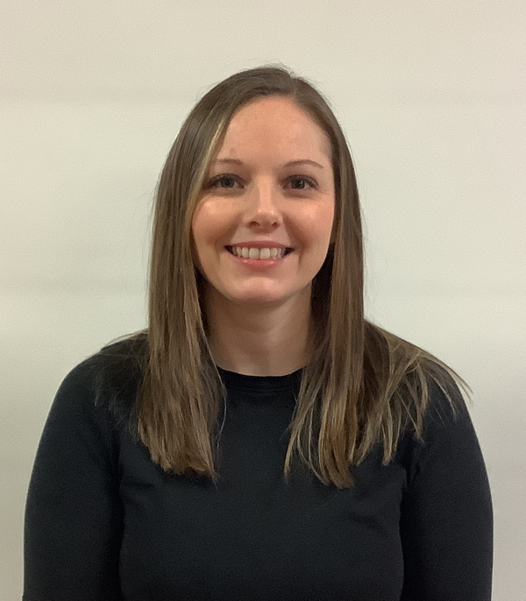
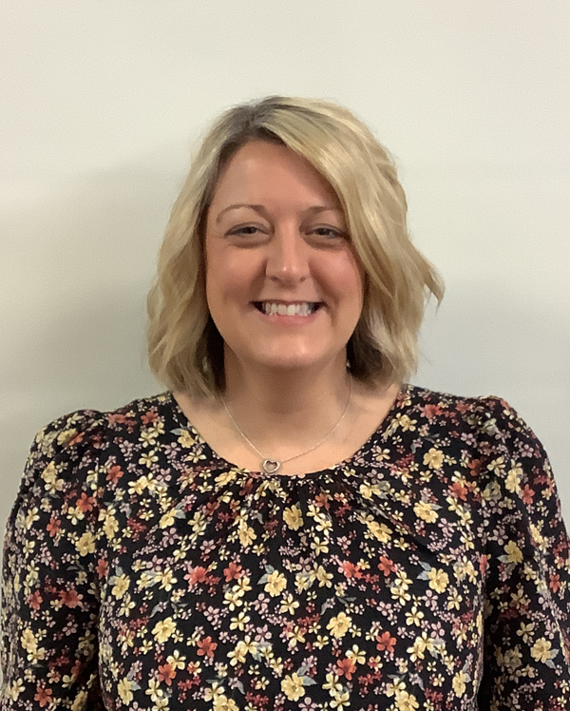
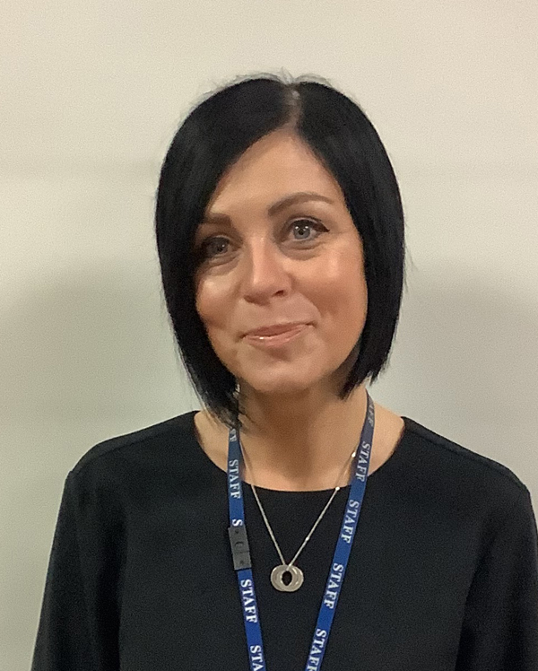
Senior Leadership Team
Josie O’Donnell
Headteacher
Emma Durham
Deputy Headteacher
Charlotte Young
Assistant Headteacher
Acting Deputy Headteacher
Marie McCuaig
Assistant Headteacher
(Mat leave)
Acting Assistant Headteacher
Sharon Walker
Senior Family Support Practitioner
Rebecca Dallman
School Business Manager

Slide 18
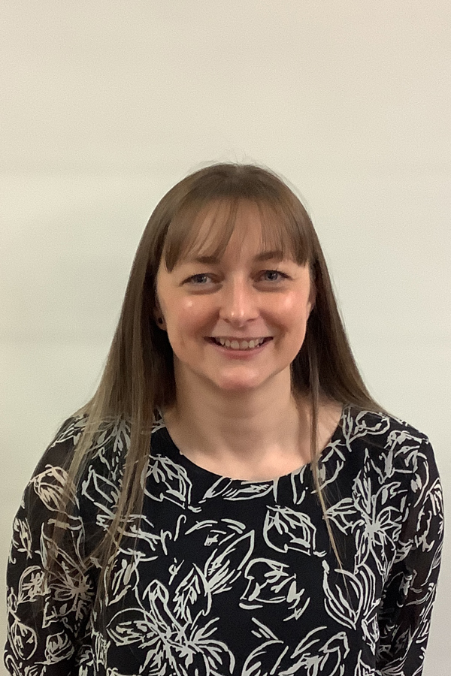
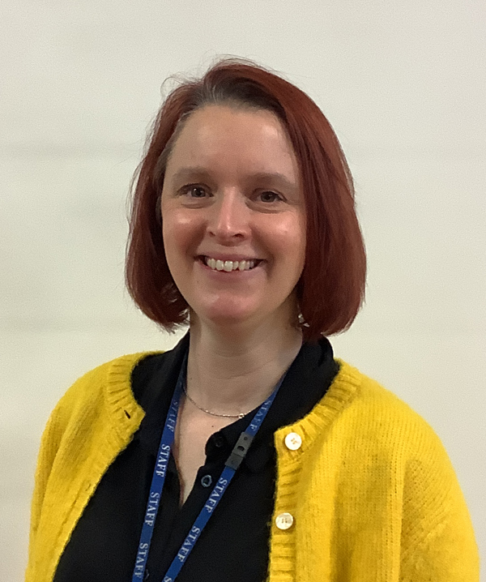
Middle Leadership Team
Katie Turner
Social, Emotional & Mental Health Lead
RSHE & PSHE
Clare Charlesworth
Communication & Interaction Lead
Staff Governor
Amy Naylor
Post-14 Lead
Careers & Accreditation

Slide 19
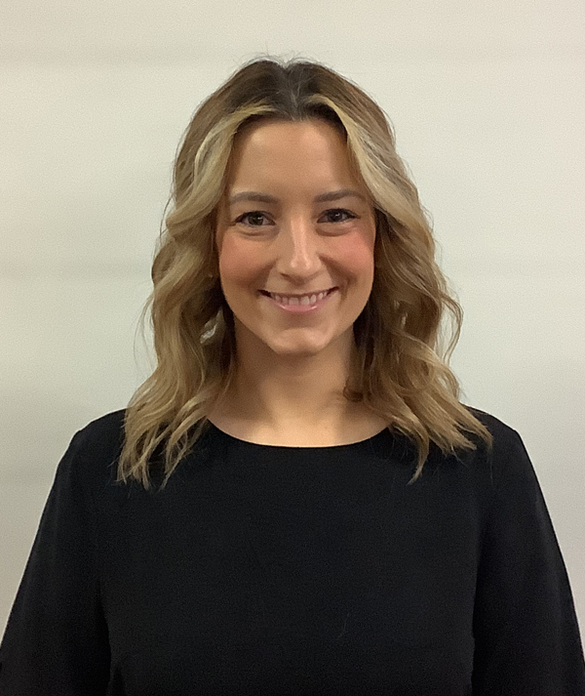
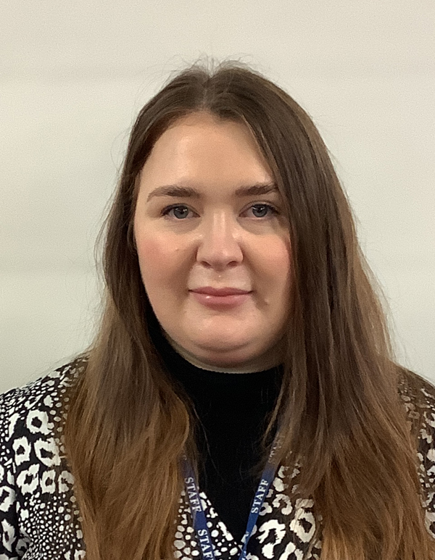
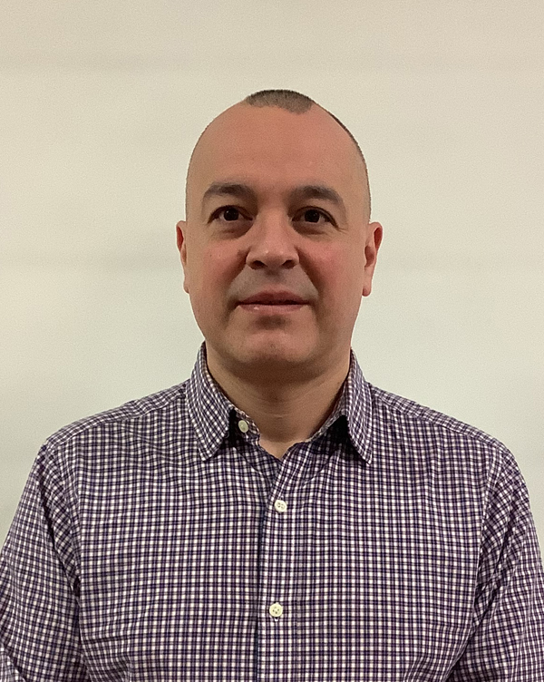
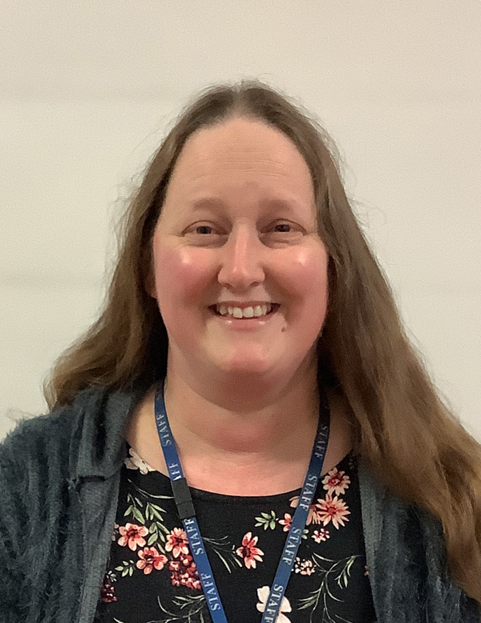
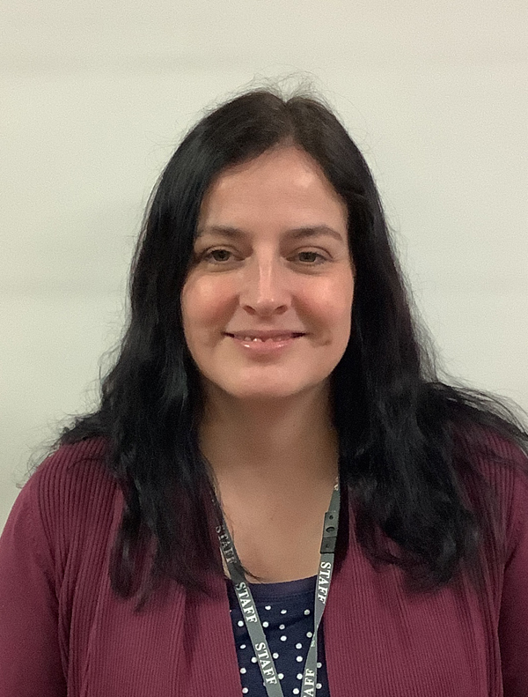
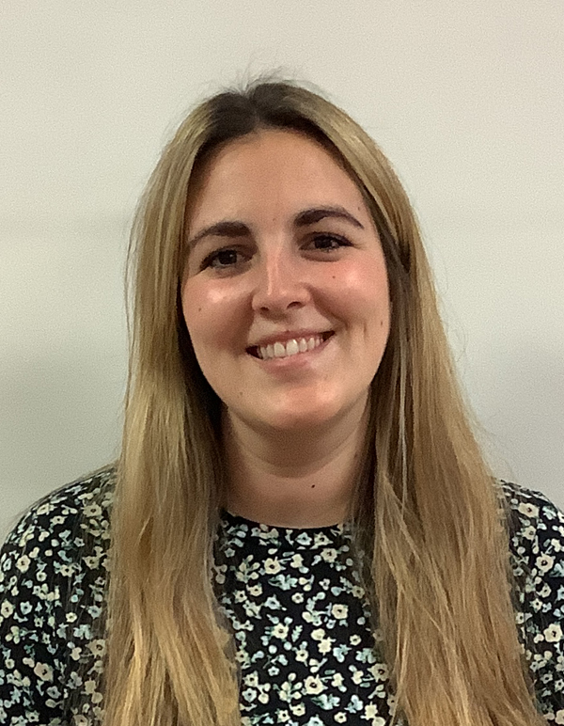
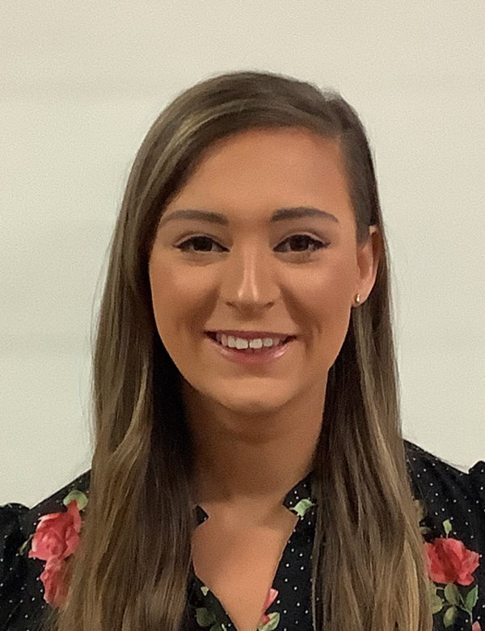
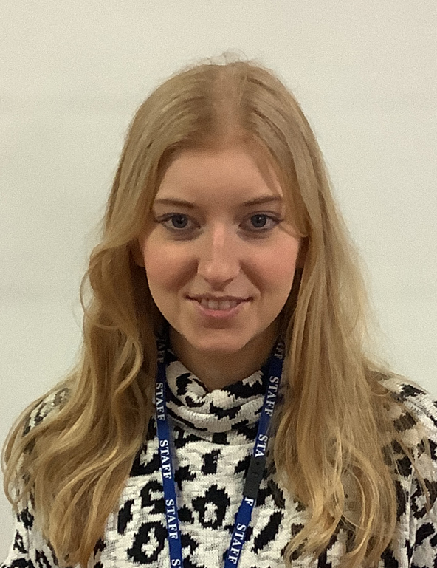
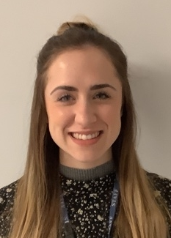
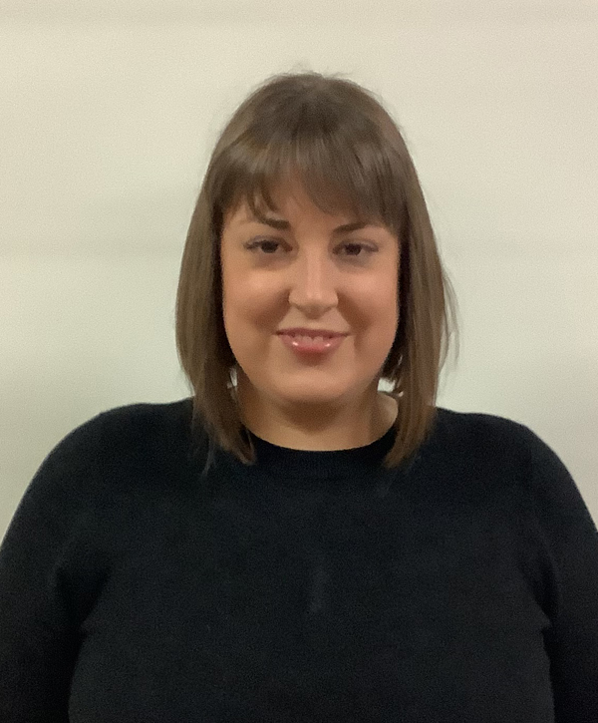
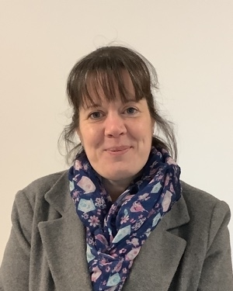
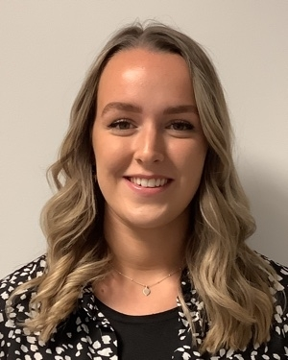
Teaching Team
Katie Henson
Katie Turner
Ceri-Anne McCallum
Marco Echeverria
Ruth Woodhouse
Louise Preston
Chanise Gregory (mat leave)
Annabelle Towndrow
Lucy Powell
Leanne Hardy
Katy Morley (Mat leave)
Victoria Sheldon
Rebecca Conway

Slide 20
Family Support
Sharon Walker
Senior Family Support Practitioner

Slide 21
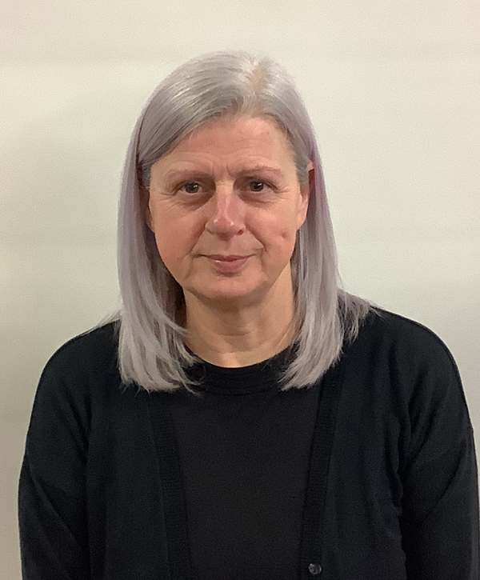
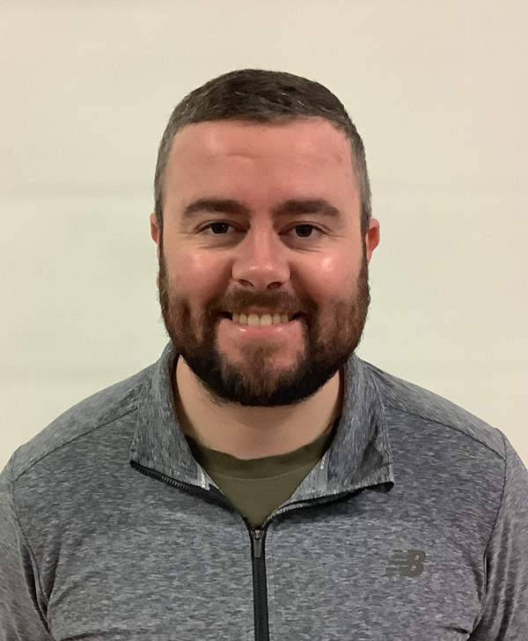
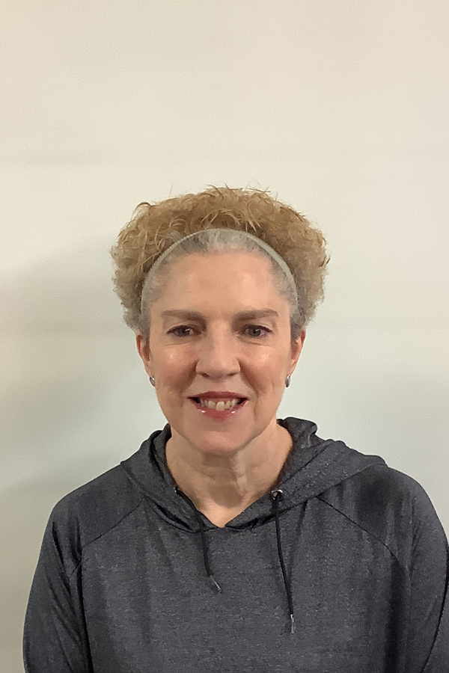
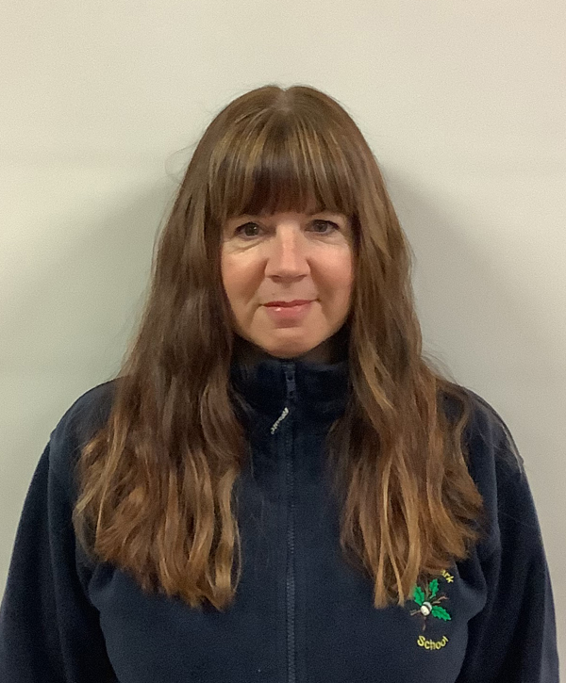
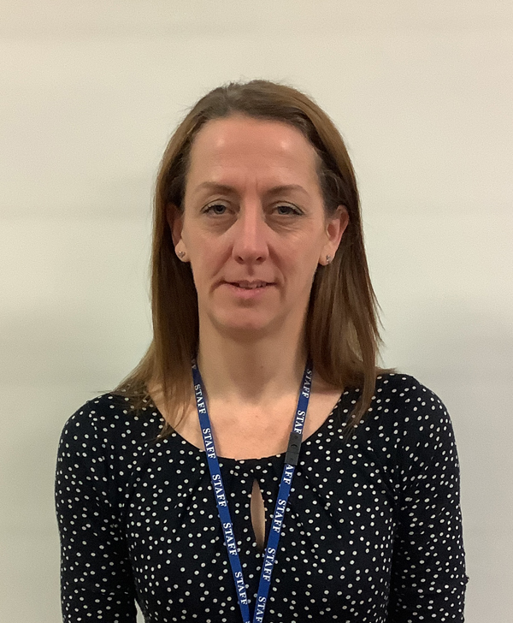
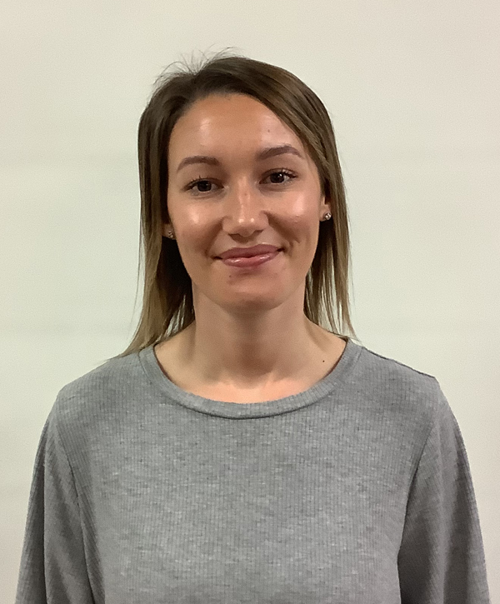
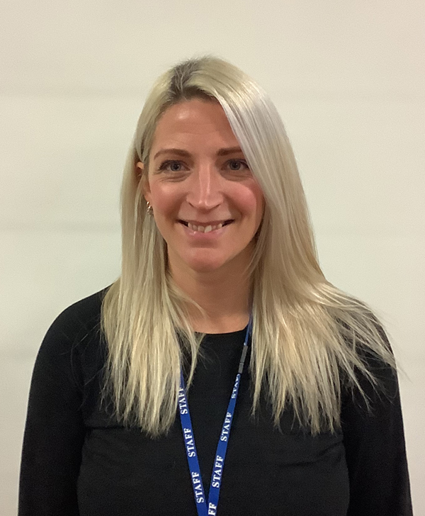
Physical Therapy Link Team
Donna Speight
Lead Therapy Link Worker
MOVE Practitioner
Moving and Handling Lead
Rebound Therapy
Joe Harrison
Hydrotherapy Pool Manager
Wendy Toft
Therapy Link Worker
Rebound Therapy
Tracy Hobson
Therapy Link Worker
Christine Frost
MOVE Practitioner
Therapy Link Worker
Shannon Parkes
Therapy Link Worker
Rebound Therapy
Michelle James
Rebound Therapy
Lifeguard

Slide 22
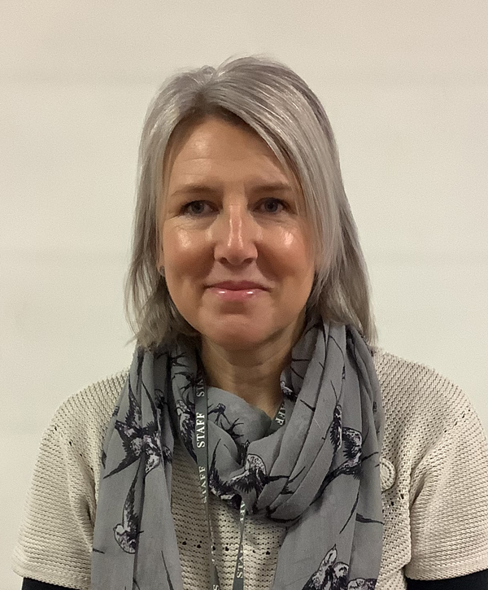
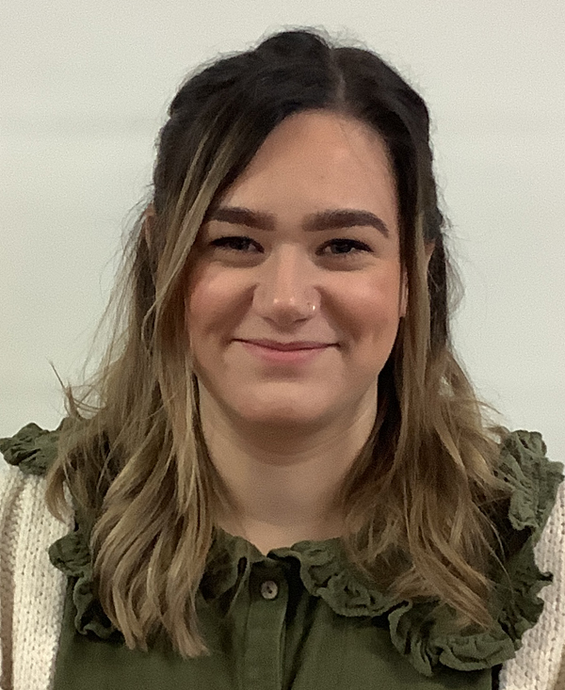
Work Experience Team
Jeanette Scarfe
Mary Mather
Richard Simpson

Slide 23
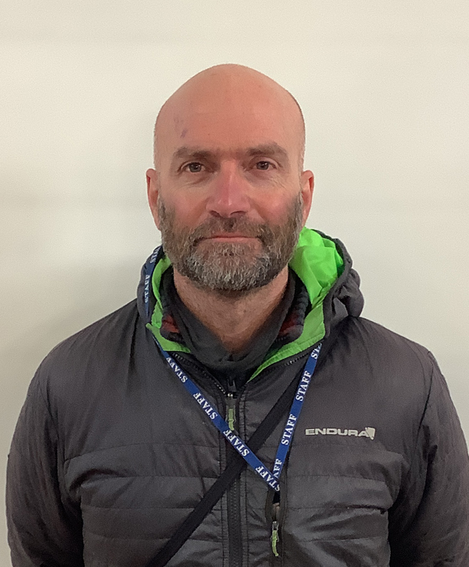
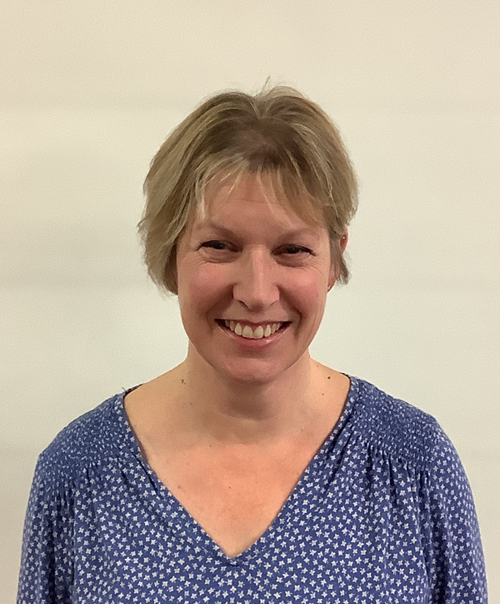
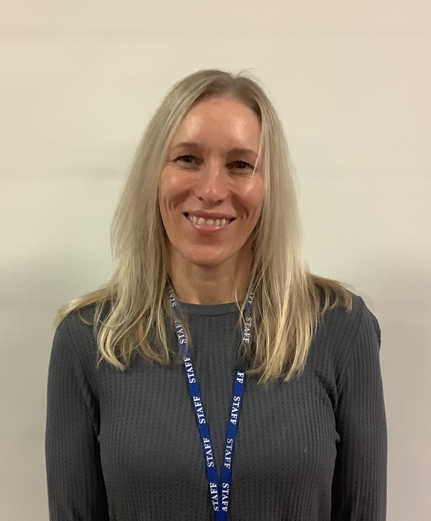
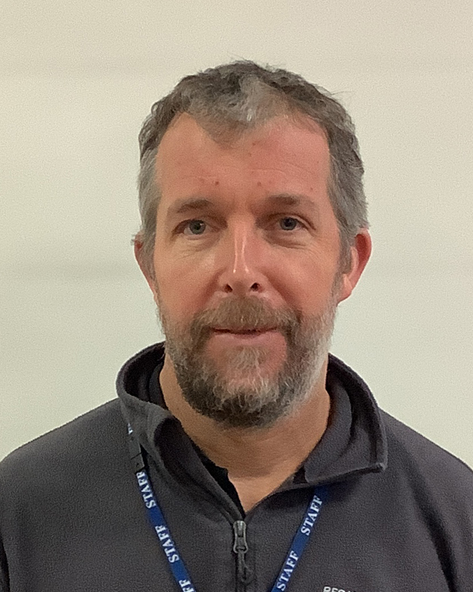
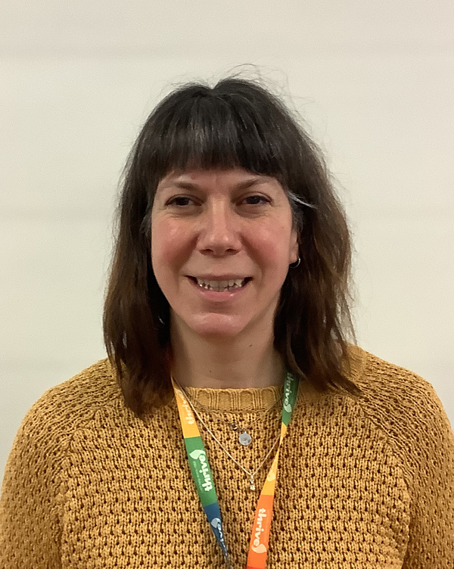
Well-being and Nurture Team
Matt Clemens
Outdoor Learning Lead
Horticulture
Lynne Radlett
Thrive Practitioner
Pupil Mental Health
Sam Butlin
Forest Schools Lead
Richard Simpson
Forest Schools Lead
Wendy Toft
Forest Schools Lead
Ed Acons
Music
Treg Marsh
Art Mentor
Thrive Practitioner

Slide 24
Behaviour Support Team
Josie O’Donnell
Emma Durham
Behaviour Team Lead
Clare Charlesworth
Sam Butlin
Katy Morley (mat leave)

Slide 25
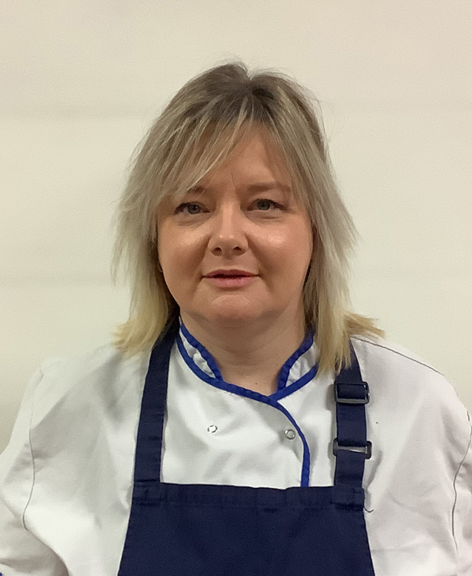
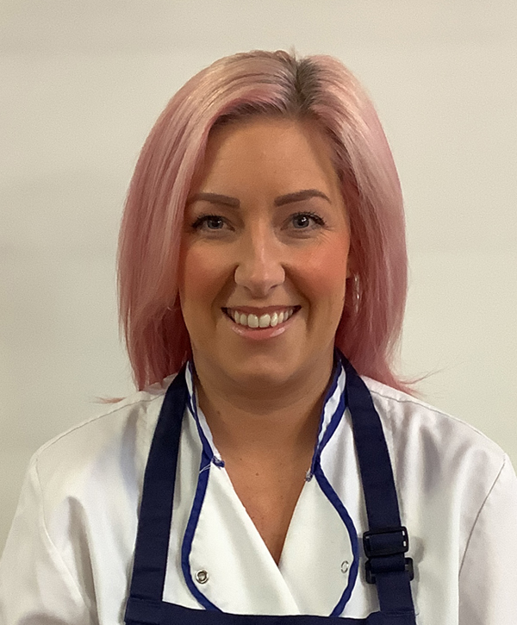
Catering Team
Yssy Neild
Sam Bradshaw

