Slide 1
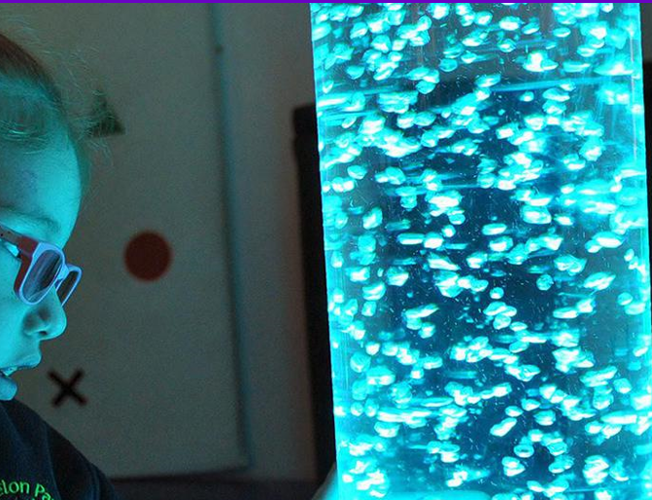
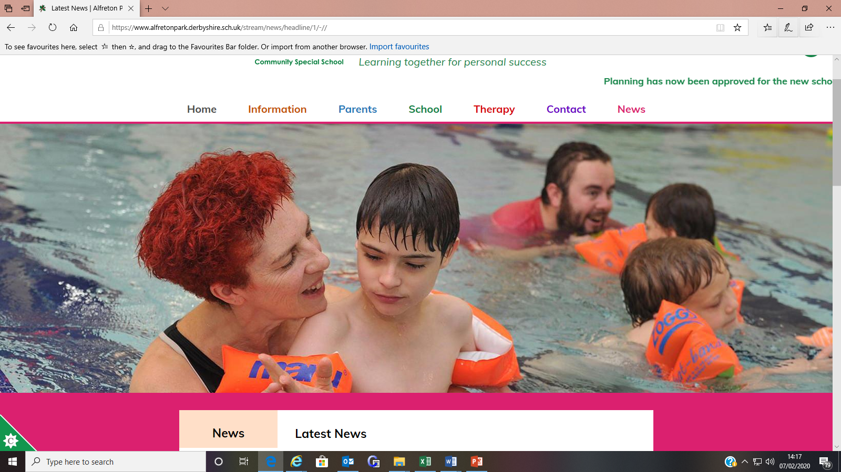
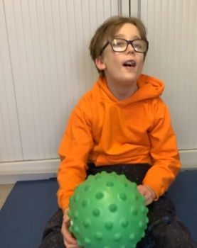
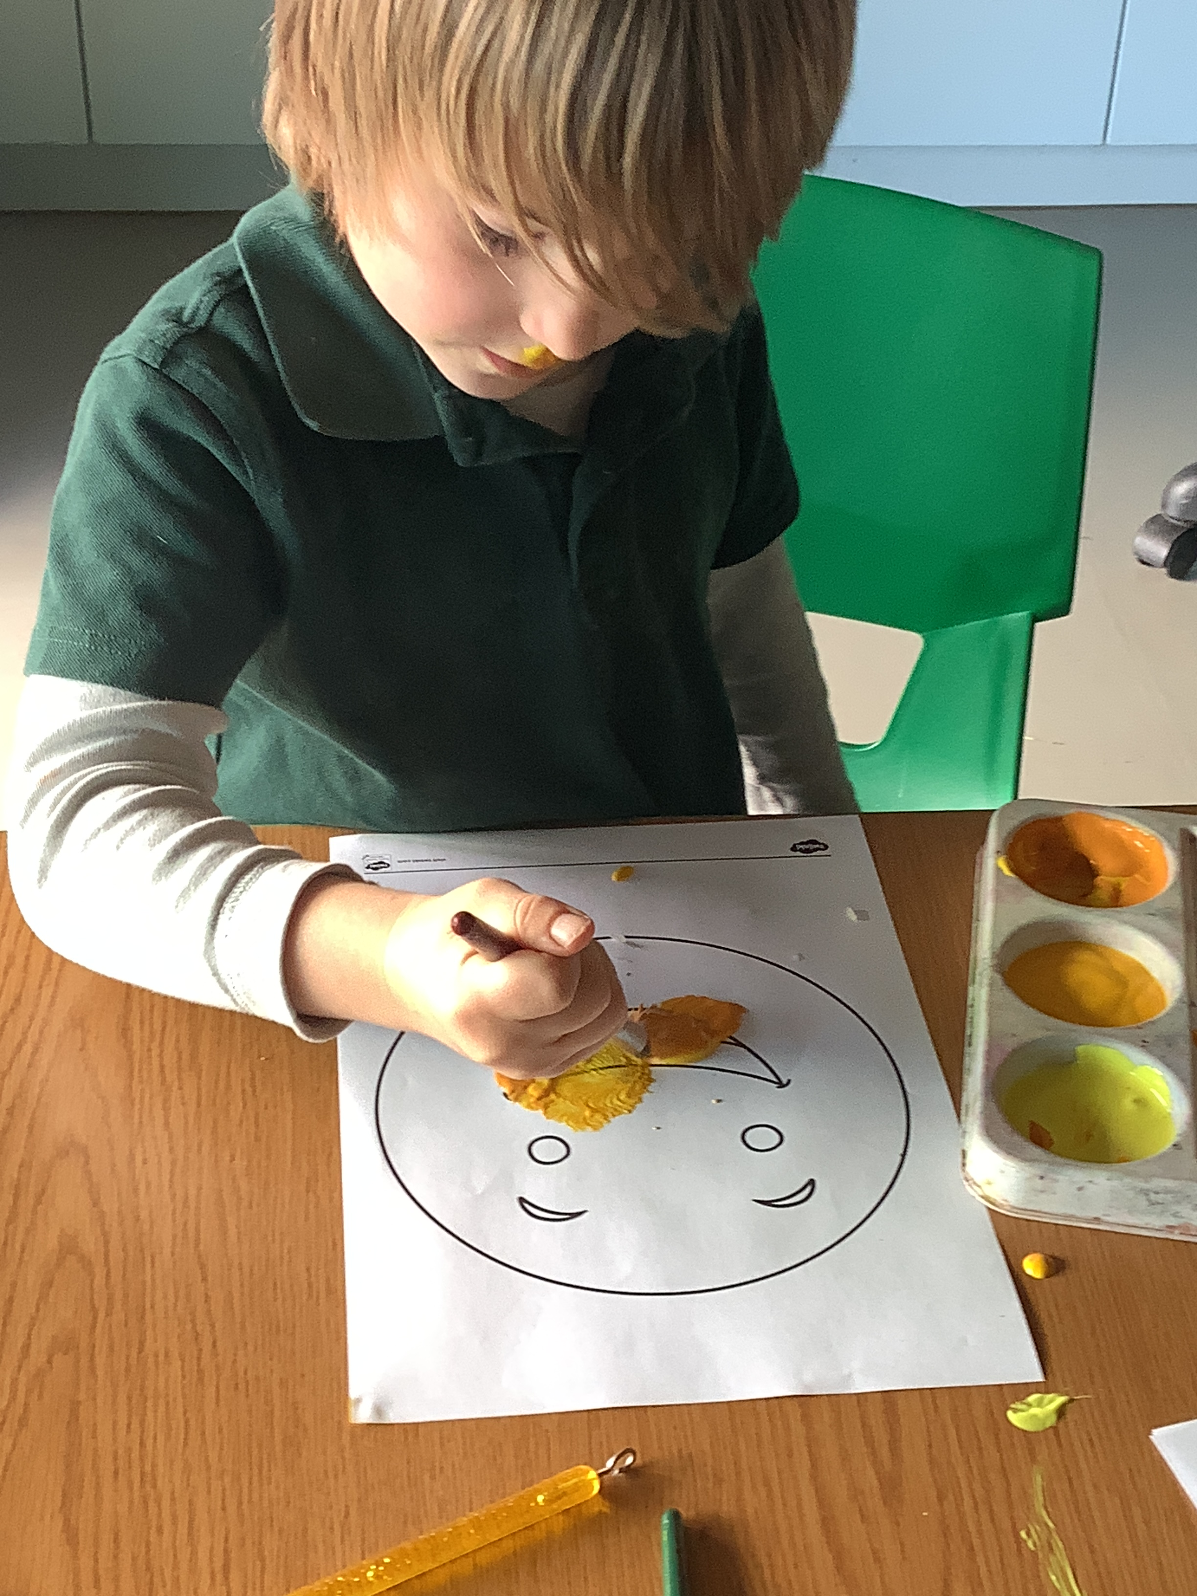
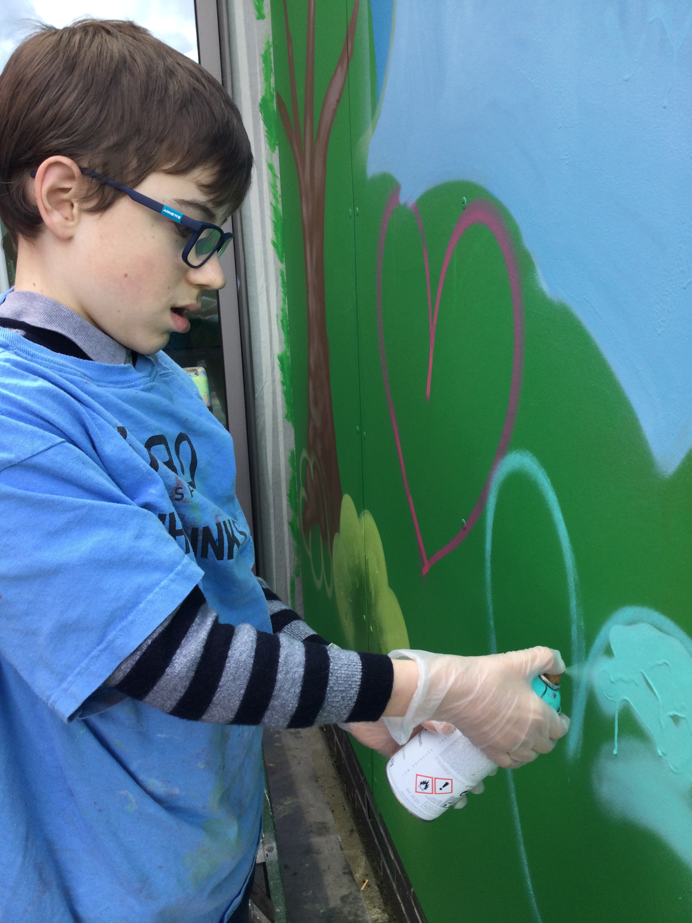

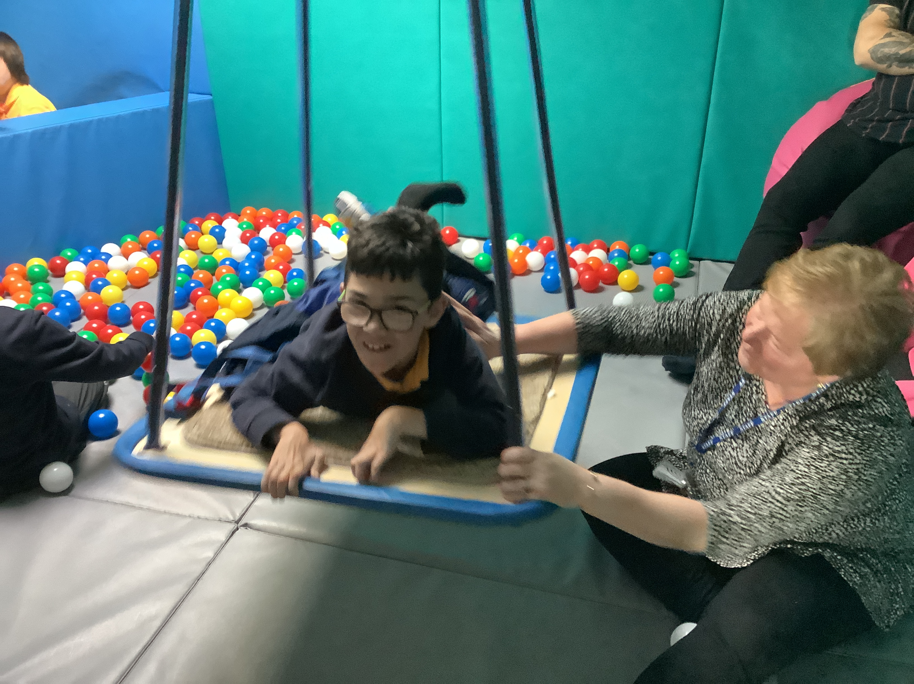
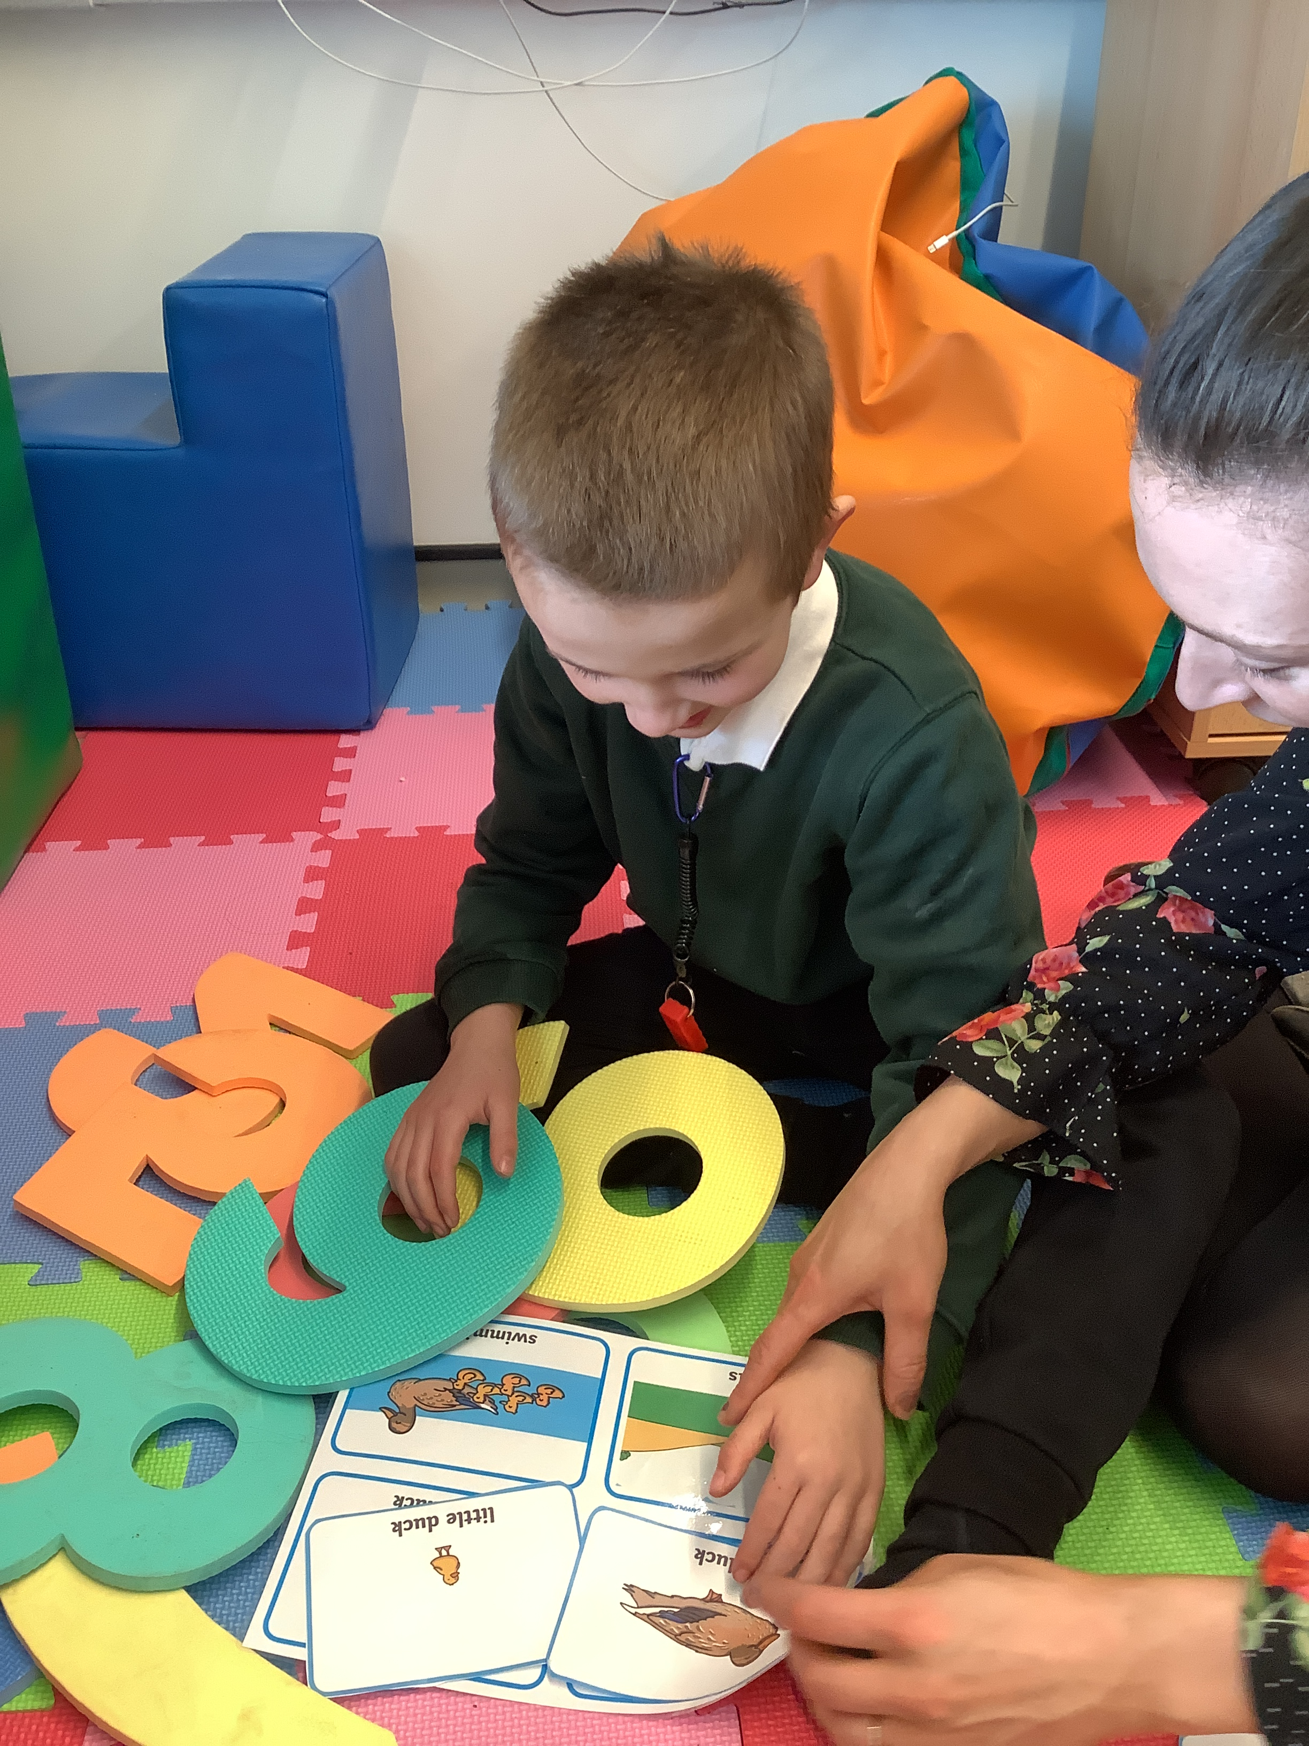
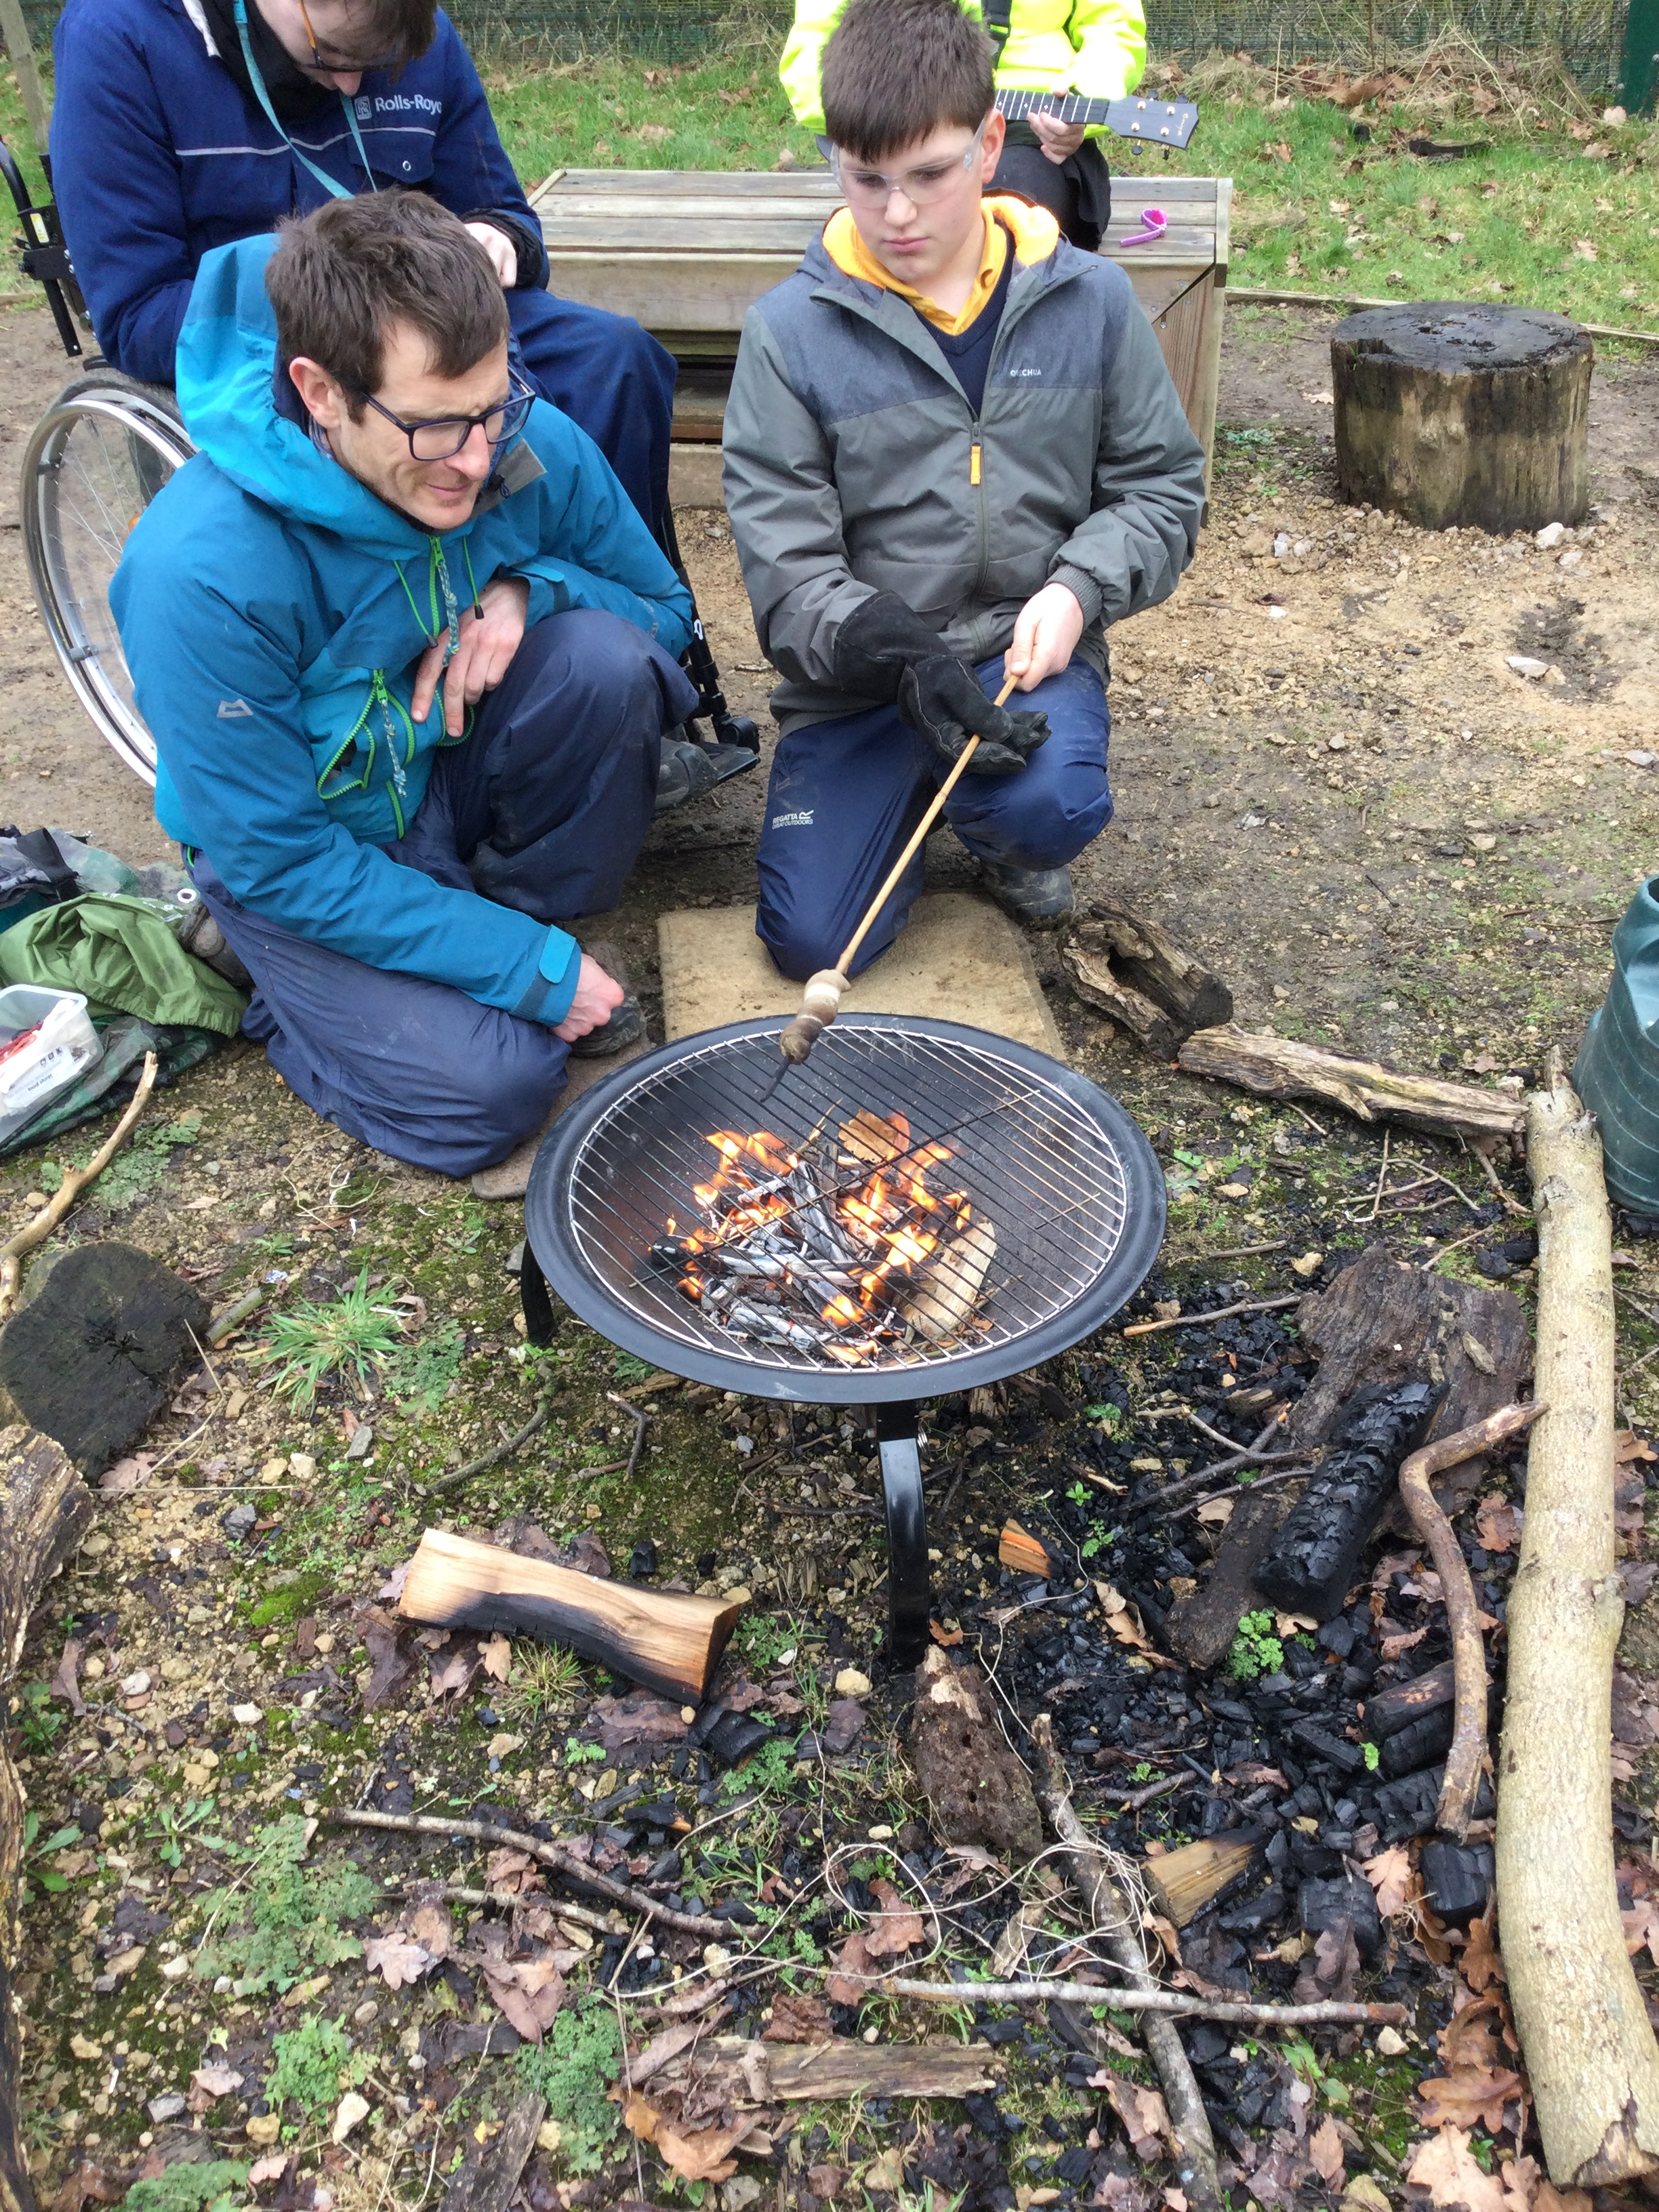
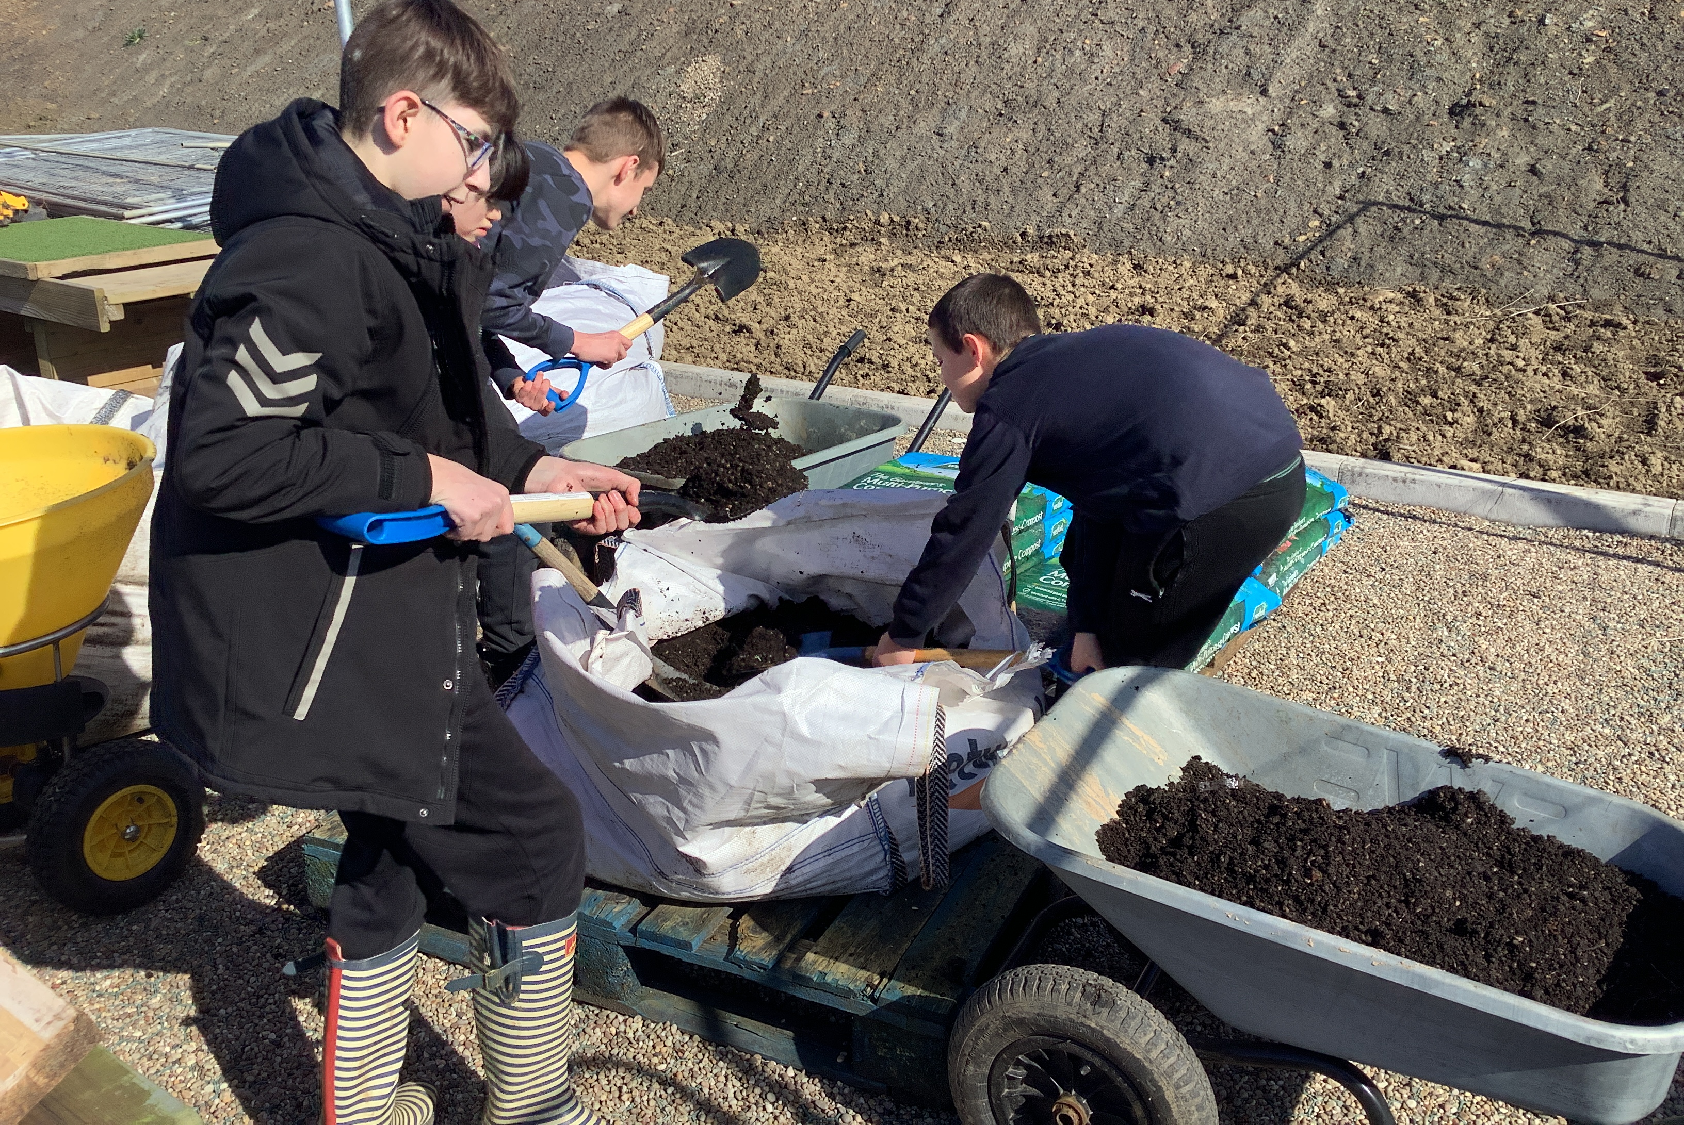
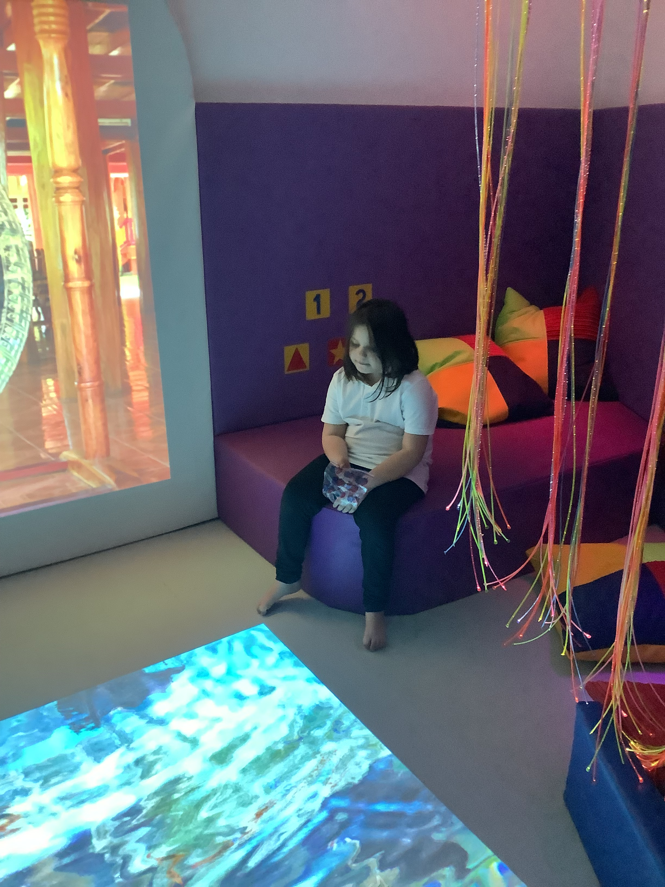
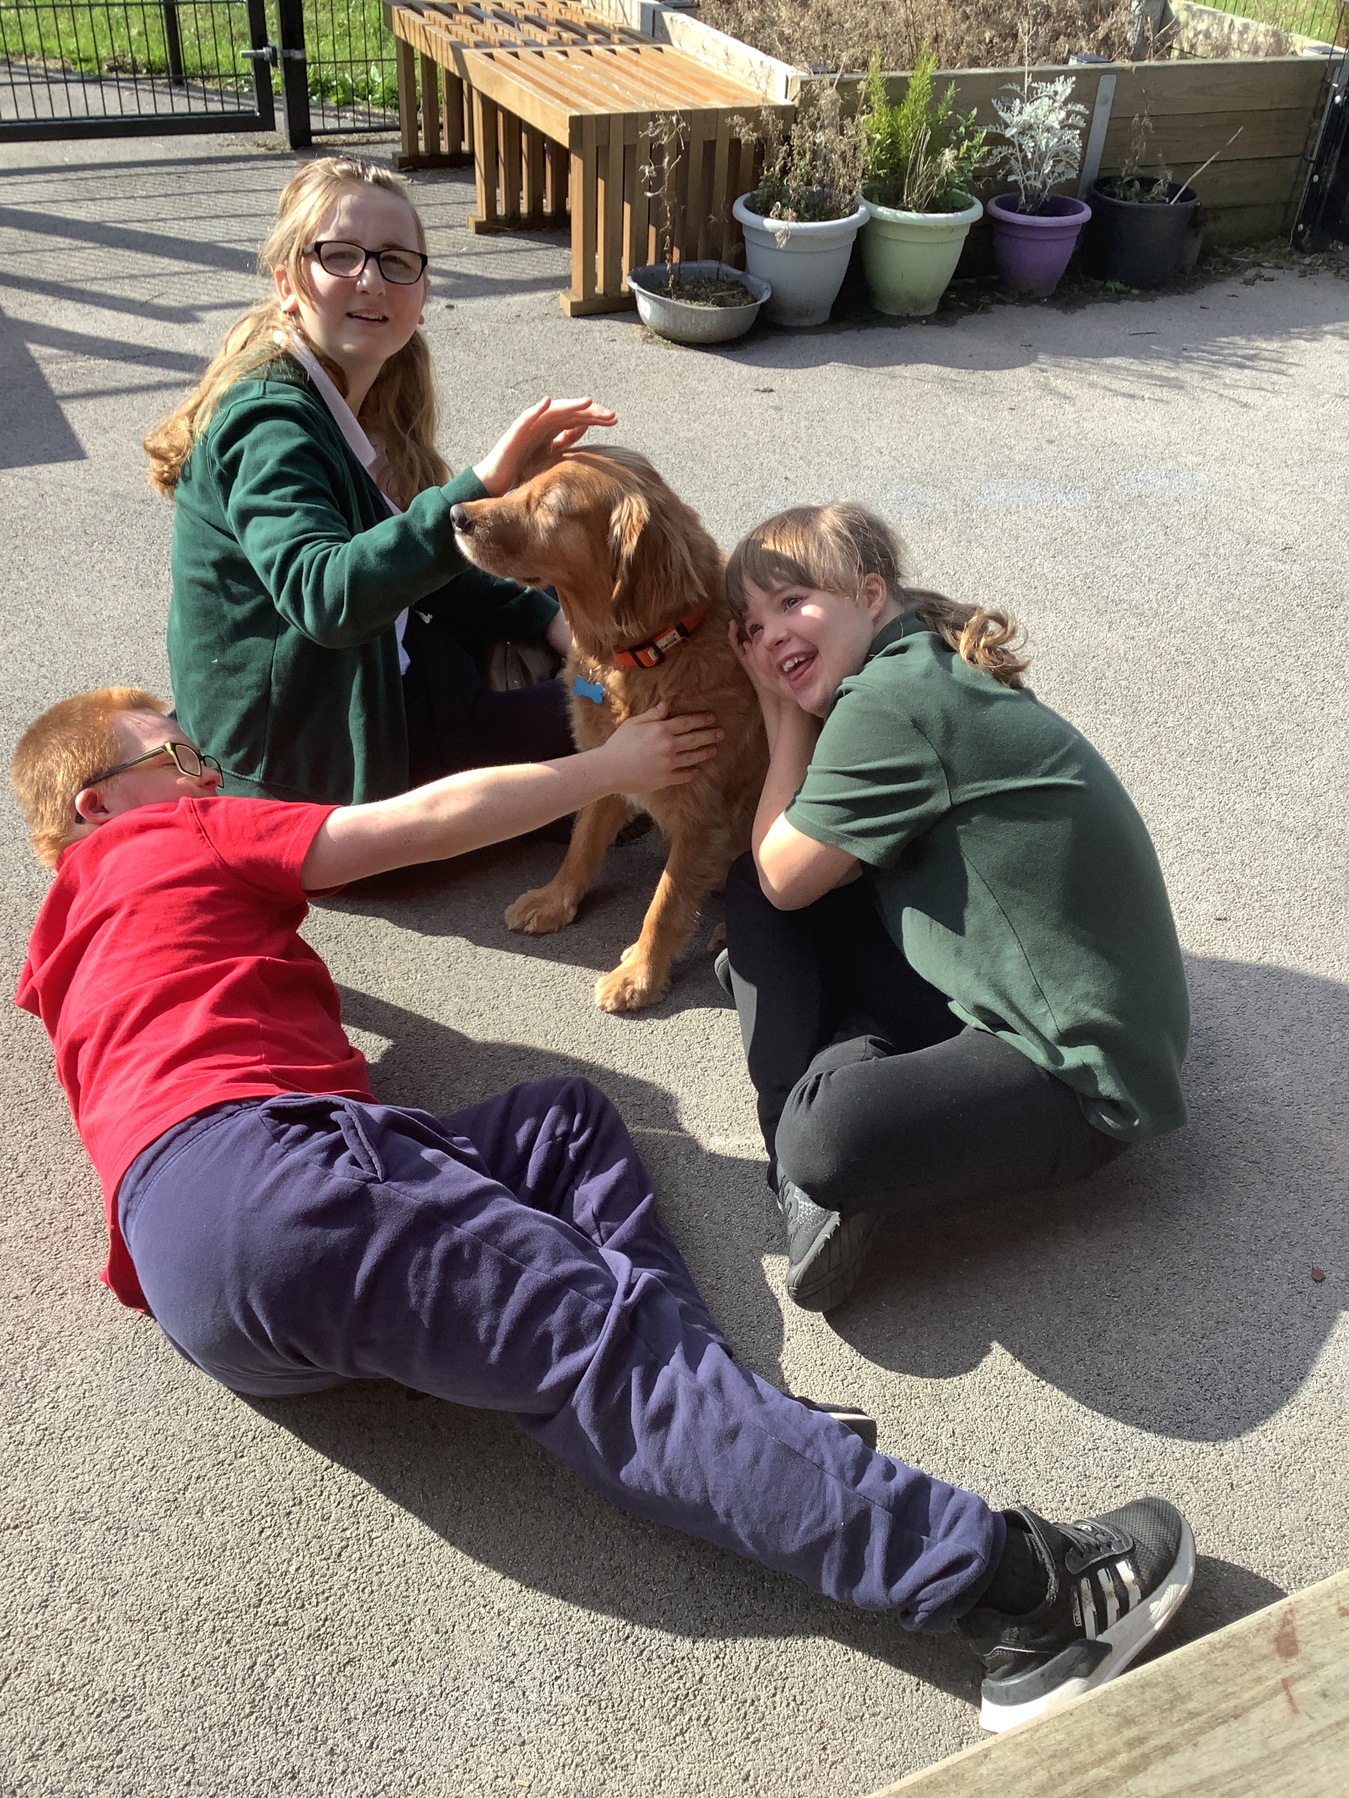
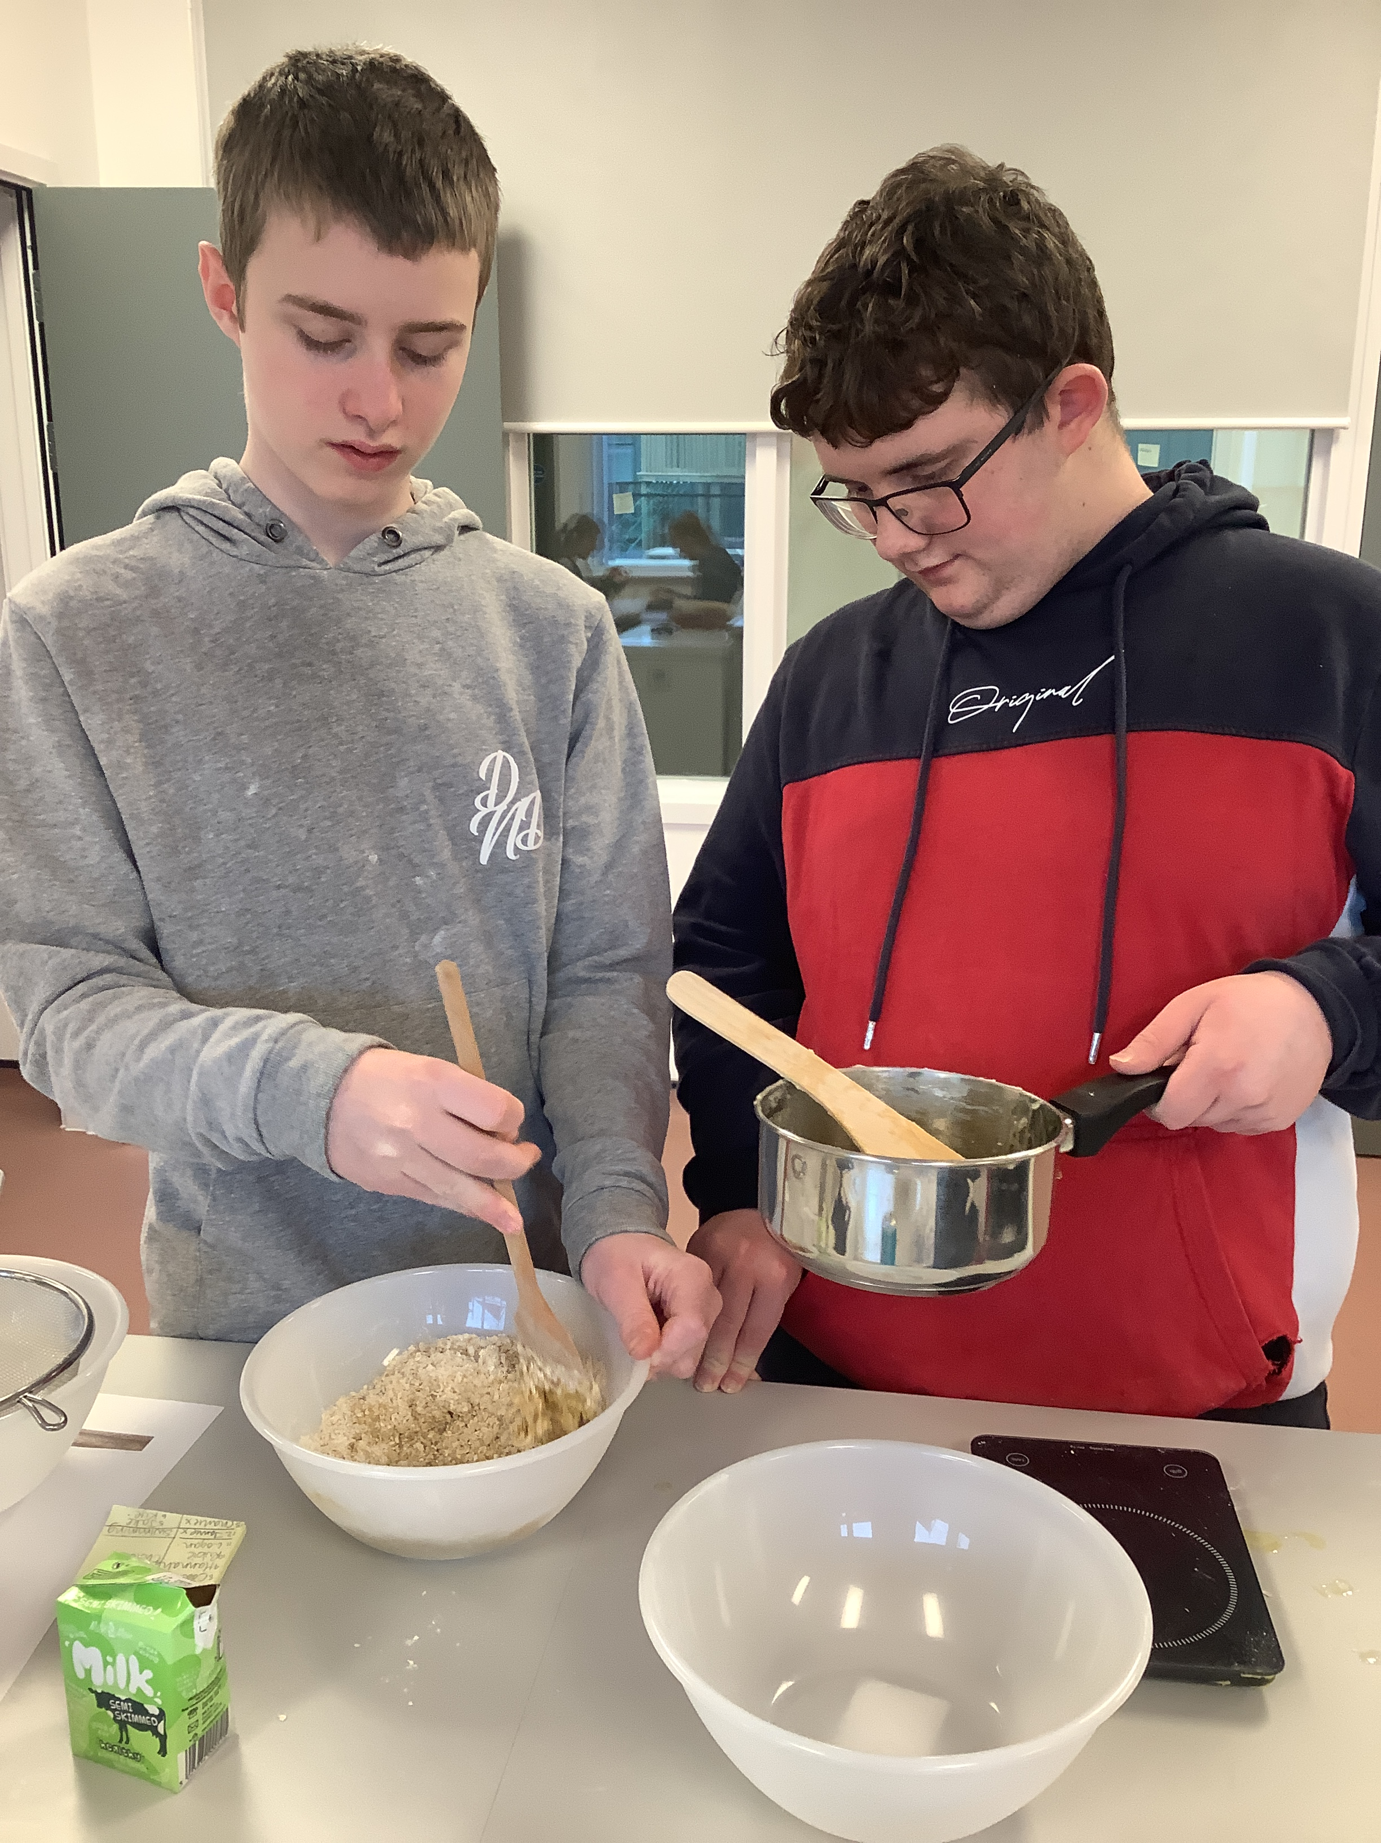
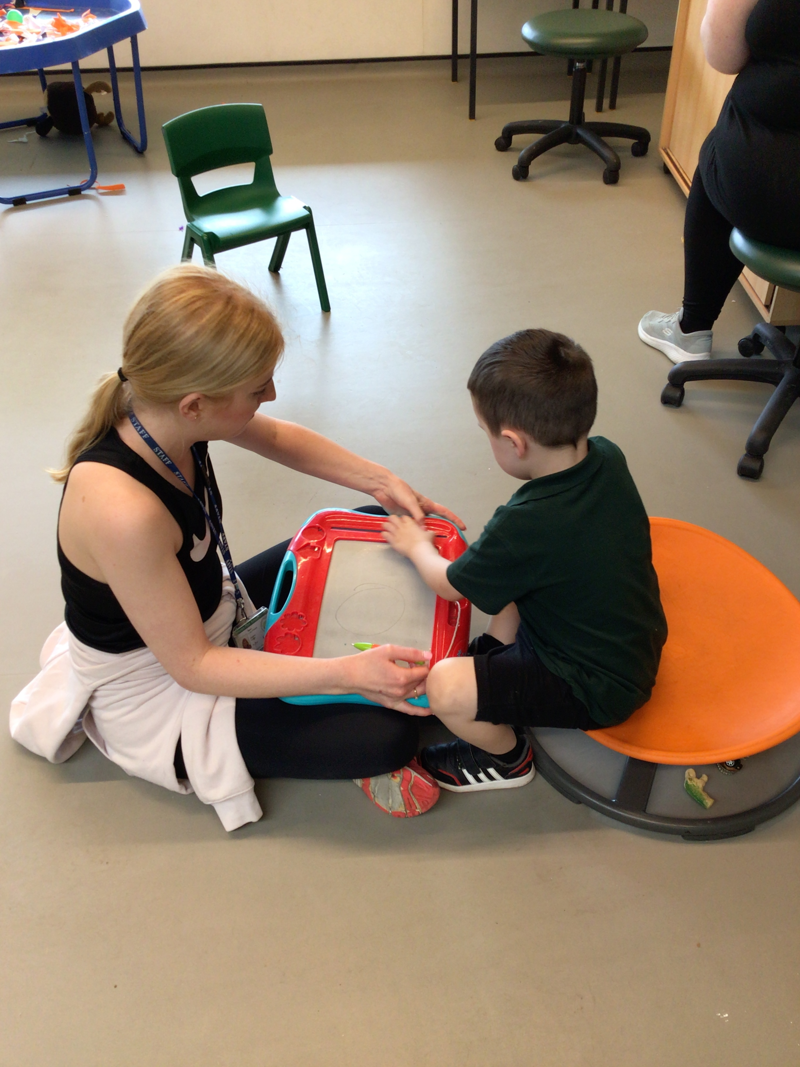

Slide 2
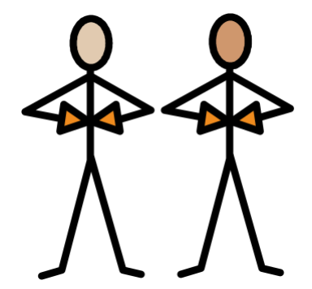
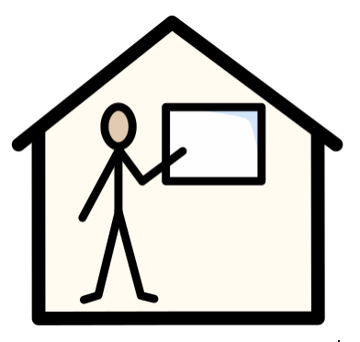
School Context
We are an all-through (2-19) special school, accommodating a wide range of pupils with SEND.
We have small classes of between 6 and 15 pupils, each with a teacher and between 1 and 5 teaching assistants.
Classes are divided into Early Years, Primary, Secondary and Post-14 departments.
Classes are grouped by a combination of need, age and learning style.
Our pupils have severe, complex and profound learning difficulties, with many of them on the autistic spectrum. We also support pupils with additional medical needs, physical disabilities and more.
We are a happy, caring community focused on helping our pupils to learn, problem solve, develop interests, independence and social skills and grow to discover their place in the adult world, through an individualised curriculum.

Slide 3
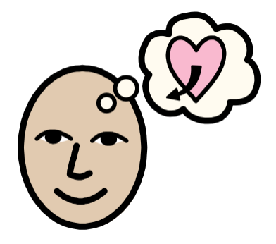
Our Vision
We recognise the challenges our pupils face and the need for them to understand respect, develop resilience and be ambitious, aiming for the moon and falling amongst the stars. All of our pupils are capable of contributing meaningfully to society and in their local community there are increasing opportunities to do so; our role is to facilitate this by working closely with stakeholders to effectively equip pupils with the necessary knowledge and skills for their next stage.
Alfreton Park School’s vision is that pupils, staff, families and the local community collectively learn and progress together in a stimulating, safe and supportive environment, reaching their maximum potential in all aspects of their life.
We aim to promote independence at every given opportunity
in a safe and nurturing environment.

Slide 4
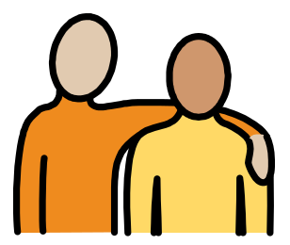
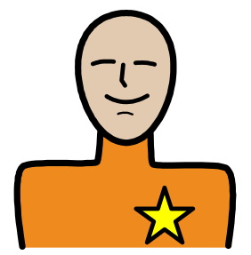
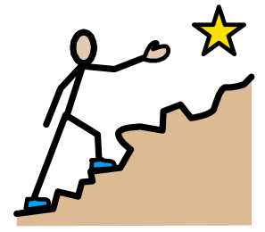
Our Values
We’re Caring Pupils experience a wide range of differences in ways appropriate to their level of understanding They develop an awareness that many people have a range of different views and beliefs Equally, they feel able to be themselves and feel respected by others Being caring is the role of the whole school community and supporting adults strive to educate the wider community on the wonderful qualities our pupils hold, and ensure they receive the respect and care that they deserve We expect that members of our school community have a caring attitude towards one another We insist on mutual respect as a minimum. | We’re Brave Being brave represents being proud of who you are, trying new things, feeling secure in communicating with new people, visiting unfamiliar places, being part of new experiences and feeling confident to ask for help It is the role of supporting school community members to facilitate this, equipping pupils with the knowledge, skills and support mechanisms to feel confident to do these things as they grow and develop Our pupils, again just like many, many other children growing into young adults, face challenges and will continue to do so in adult life. It is the school community’s responsibility to prepare them and help them to cope with this in the best way that works for them (and in our context, this does not mean facing it alone!) Pupils develop strategies to help cope with unforeseen change, or when their feelings overwhelm them Being brave for supporting adults in our school community means allowing our pupils to take risks, exposing them to new opportunities and not underestimating their capabilities. | We Aim High We want our pupils to maintain their ambition throughout life. The school community should not settle for less than they are capable of Aiming high links to physical independence, forming relationships, being able to communicate effectively and successfully, accessing their local and wider community It is the role of the wider school community to promote pupils’ strengths and facilitate their ambitions in a way that is appropriate for each individual Pupils aim to find out ‘who’ they are – developing interests and hobbies Pupils form relationships, attain employment and access the wider community, feeling a sense of belonging They foster a love of learning that they take with them beyond school into adulthood

Slide 5
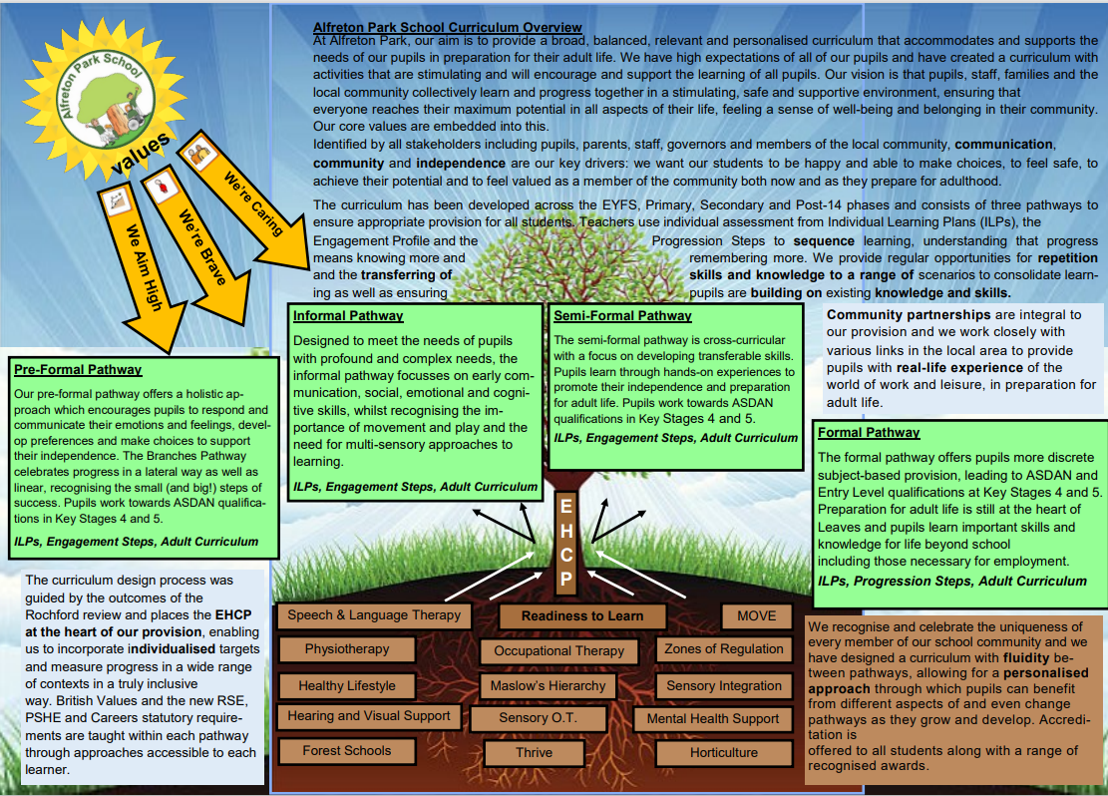
APS Curriculum
We subscribe to a pupil-centred philosophy of education, and they are at the heart of everything we do.

Slide 6
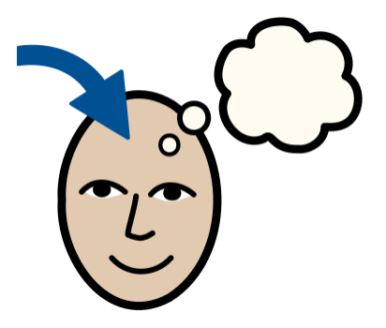
Teaching – how pupils learn
We use our knowledge of the needs of our pupils to present learning opportunities in ways that are accessible and engaging
We tailor our approach to suit the strengths and interests of our pupils, through the implementation of a wide range of specialist strategies to deliver personalised provision
We place particular importance on the development and exercise of independence not just as a goal, but as a method, and feel that our pupils learn best when they are empowered to think, say and do things for themselves wherever possible

Slide 7
Curriculum Key Staff
Headteacher
Josie O’Donnell
Deputy Headteacher
Emma Durham
Curriculum and Behaviour Lead
Marie McCuaig
Assistant Head
Physical & Sensory Lead
EYFS
Clare Charlesworth
Assistant Head
Communication & Interaction Lead
Leanne Squires
Assistant Head
English and Maths Lead
Amy Naylor
Post-14 Lead
Careers Lead
Accreditation
Lucy Powell
EYFS and Nurture Lead
Chanise Gregory
Cognition and Learning Lead
Katie Turner
Social, Emotional & Mental Health Lead
PSHE/RSHE
Katy Morley
Sensory Integration and Behaviour
Ruth Woodhouse
Music
Annabelle Towndrow
Attention Autism
Ed Acorns
Music & Drama
TA
Jeannette/ Mary
Work Experience TAs
MOVE & Physical Link Worker
Donna Allsop
Wendy Toft, Sam Butlin, Richard Simpson
Forest Schools
Matt Clemens Horticulture
Treg Marsh
Thrive Practitioner
TA
Treg Marsh
Art
TA
Tracy Cross
Communication
TA

Slide 8

Interventions and Learning Approaches
Blank Levels
http://www.elklan.co.uk/
Read, Write, Inc.
http://www.ruthmiskin.com/
Attention Autism
http://www.ginadavies.co.uk/
Horticulture
Therapeutic Arts
Sherborne
http://www.sherbornemovementuk.org/
MOVE
https://www.enhamtrust.org.uk/what-is-move/
Intensive Interaction
http://www.intensiveinteraction.org/
Sound Bath
https://www.healthline.com/health/sound-bath
Thrive
http://thriveapproach.com/
Open Orchestra
http://www.openorchestras.org/
Lego Therapy
https://therapyfocus.org.au/on-the-blog/what-is-lego-therapy/
Halliwick
https://www.halliwick.org/
Forest Schools
http://www.forestschoolassociation.org/

Slide 9
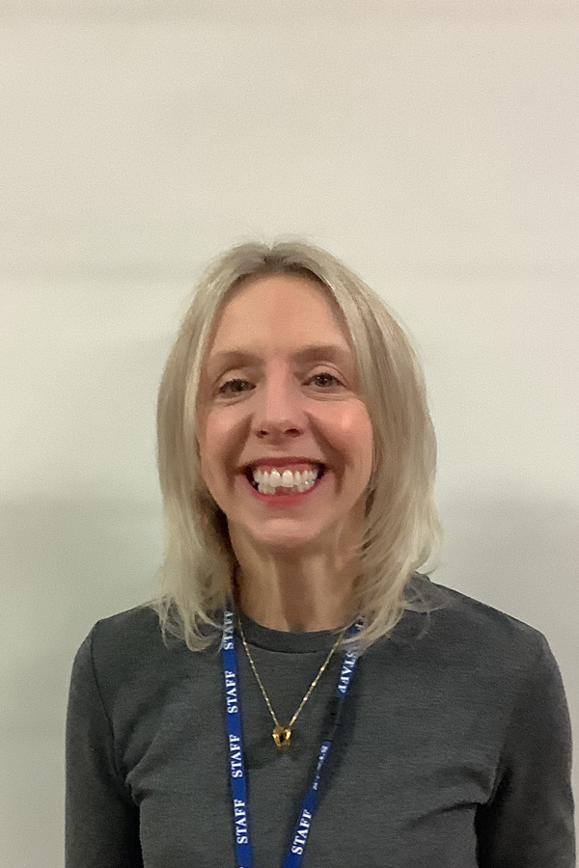
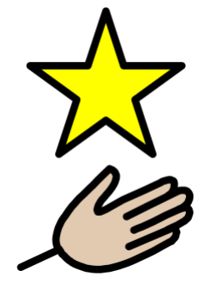
Therapies
At Alfreton Park we adhere to the SEND Code of Practice (2020), prioritising our pupils’ communication, cognition, social and emotional development and physical and sensory development above all else. We have a fantastic hydrotherapy pool which is timetabled to prioritise those pupils most in need. We also have service level agreements with both speech and language and occupational health providers to enable us to follow the best advice and support for our pupils.
Pupils benefit from weekly visits from Nicki Lees, Speech & Language Therapist (SaLT). Nicki is experienced in Alternative, Augmentative Communication (AAC) and has a wonderful relationship with our pupils.
We also have fortnightly visits from Sarah Terry, Sensory Integration Accredited Occupational Therapist (SI OT) to support pupils with their sensory needs, enabling staff to follow her guidance and follow the plans she provides to implement sensory diets several times daily as needed for each individual.
Physiotherapists visit school most weeks along with the Occupational Health team to work with pupils on their caseload.

Slide 10
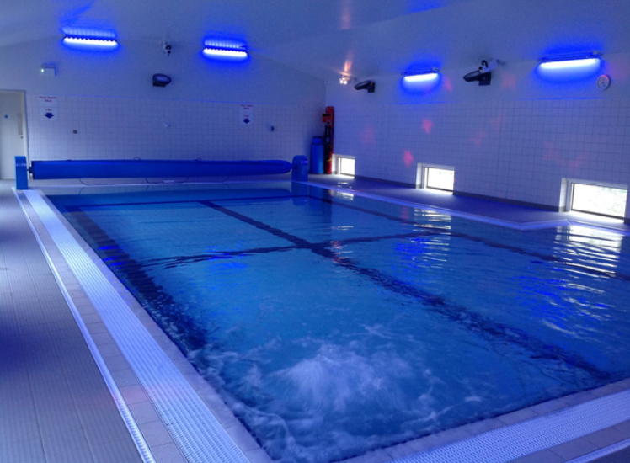
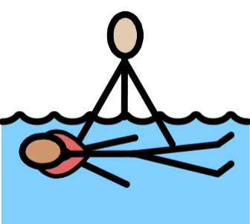
Hydrotherapy Pool

Slide 11
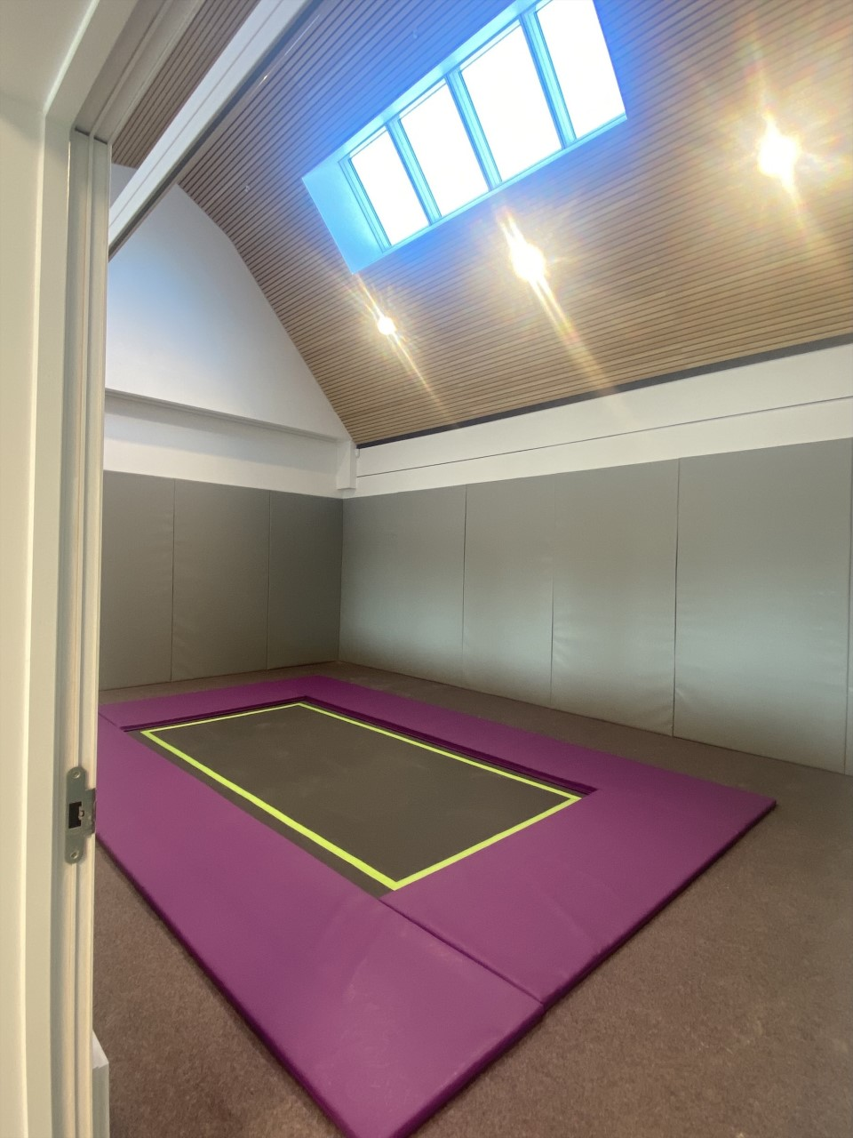
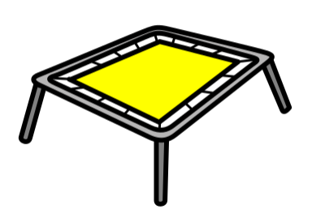
Rebound Therapy Room

Slide 12
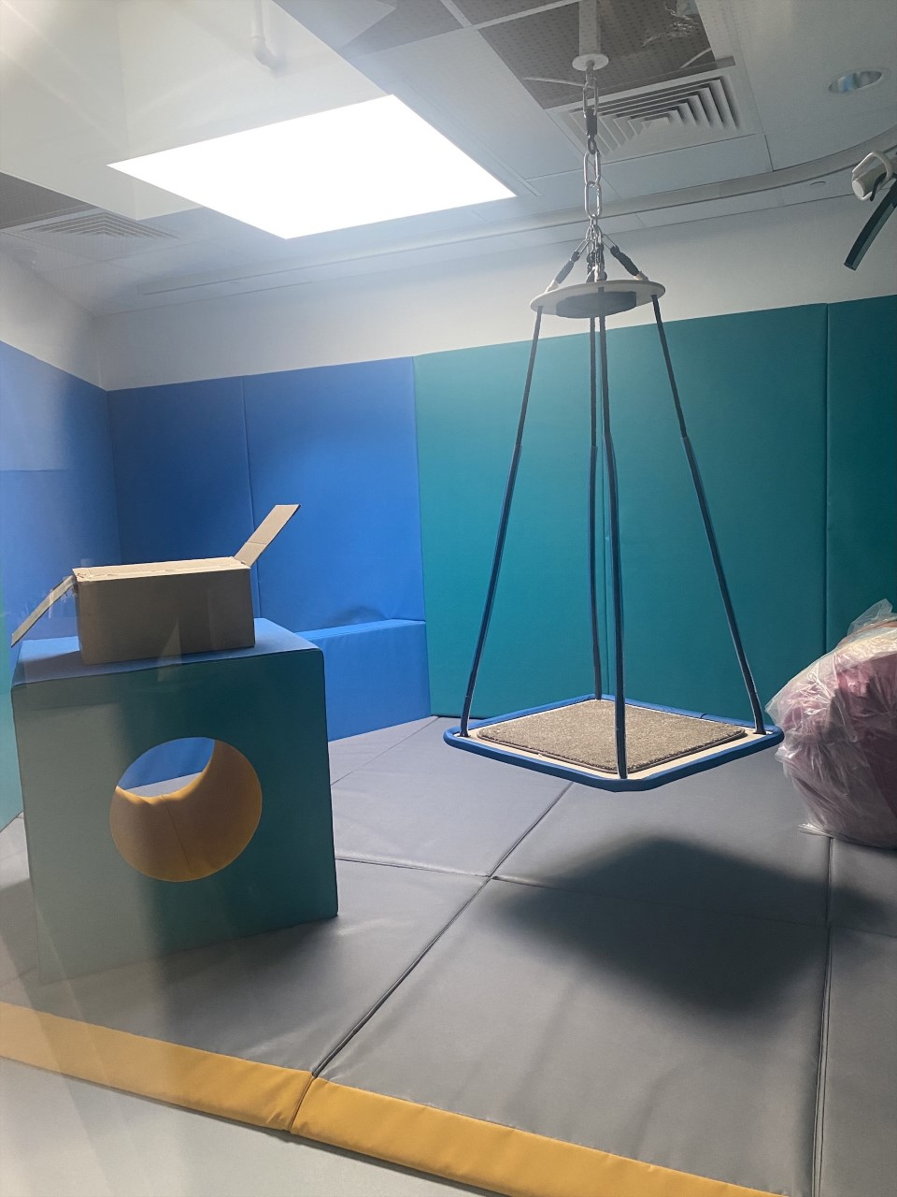
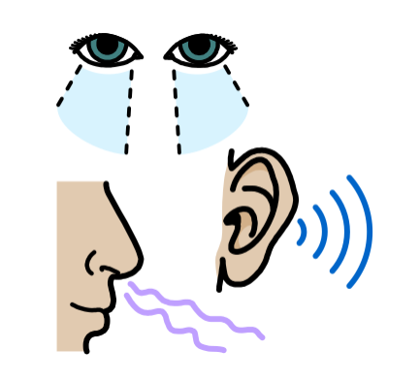
Sensory Integration Room

Slide 13
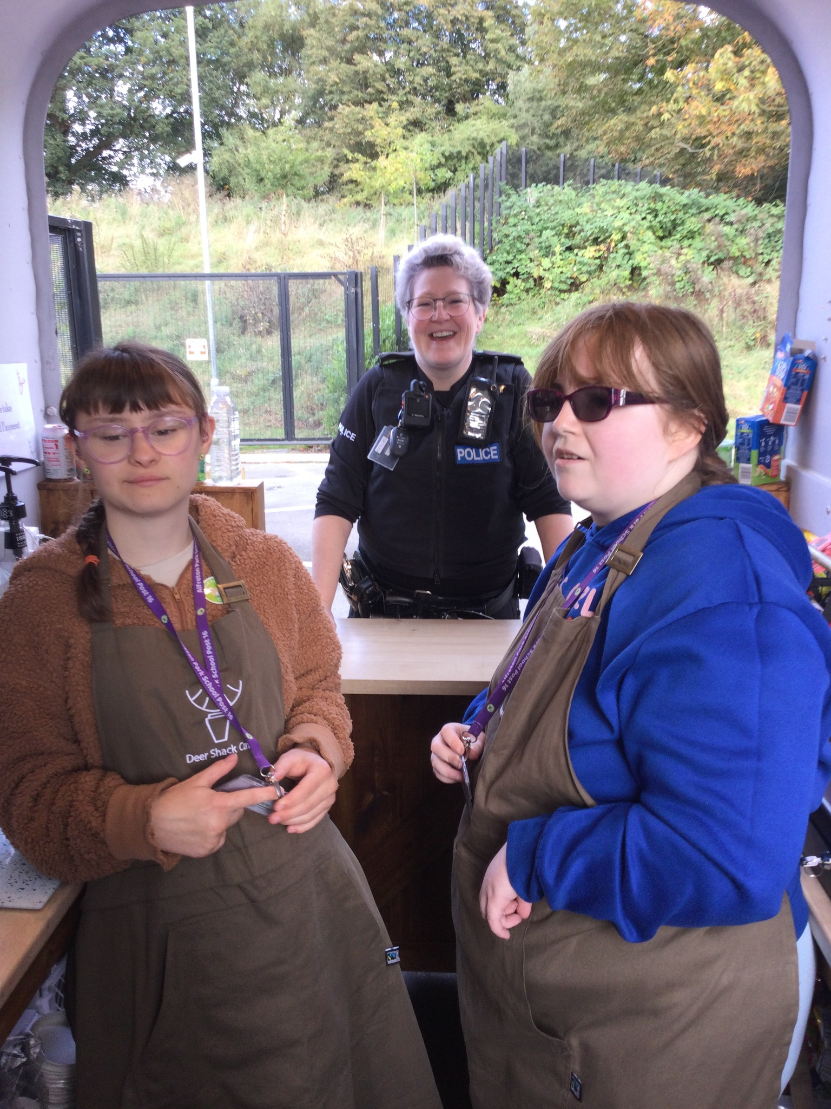
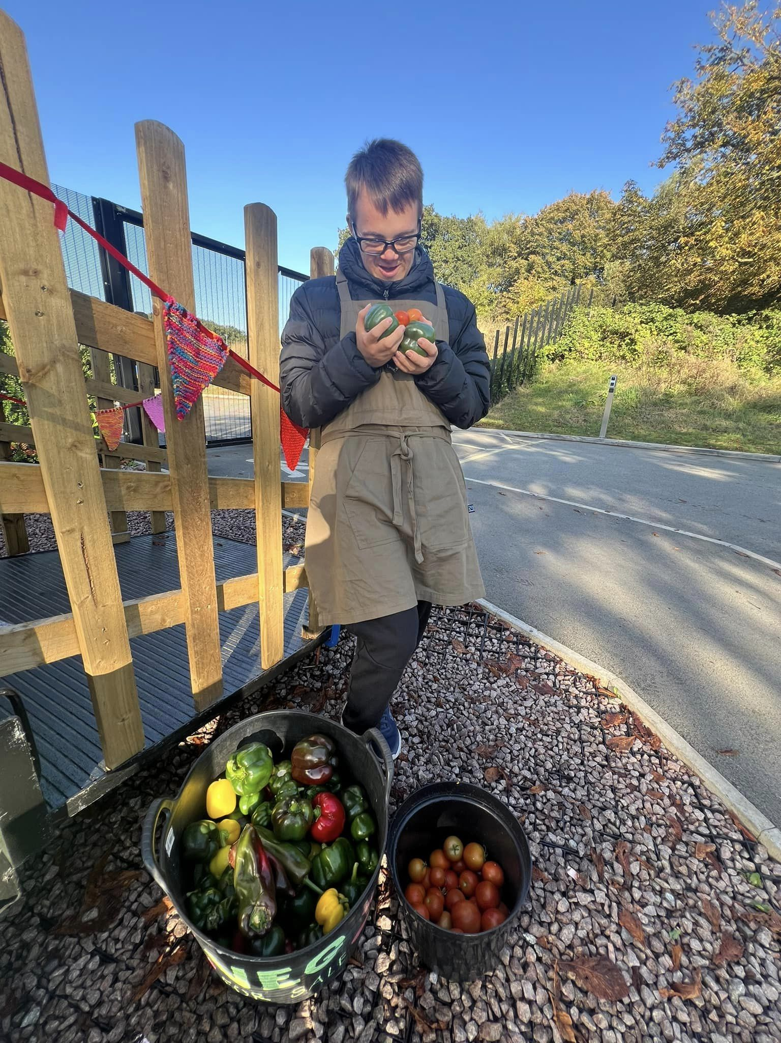
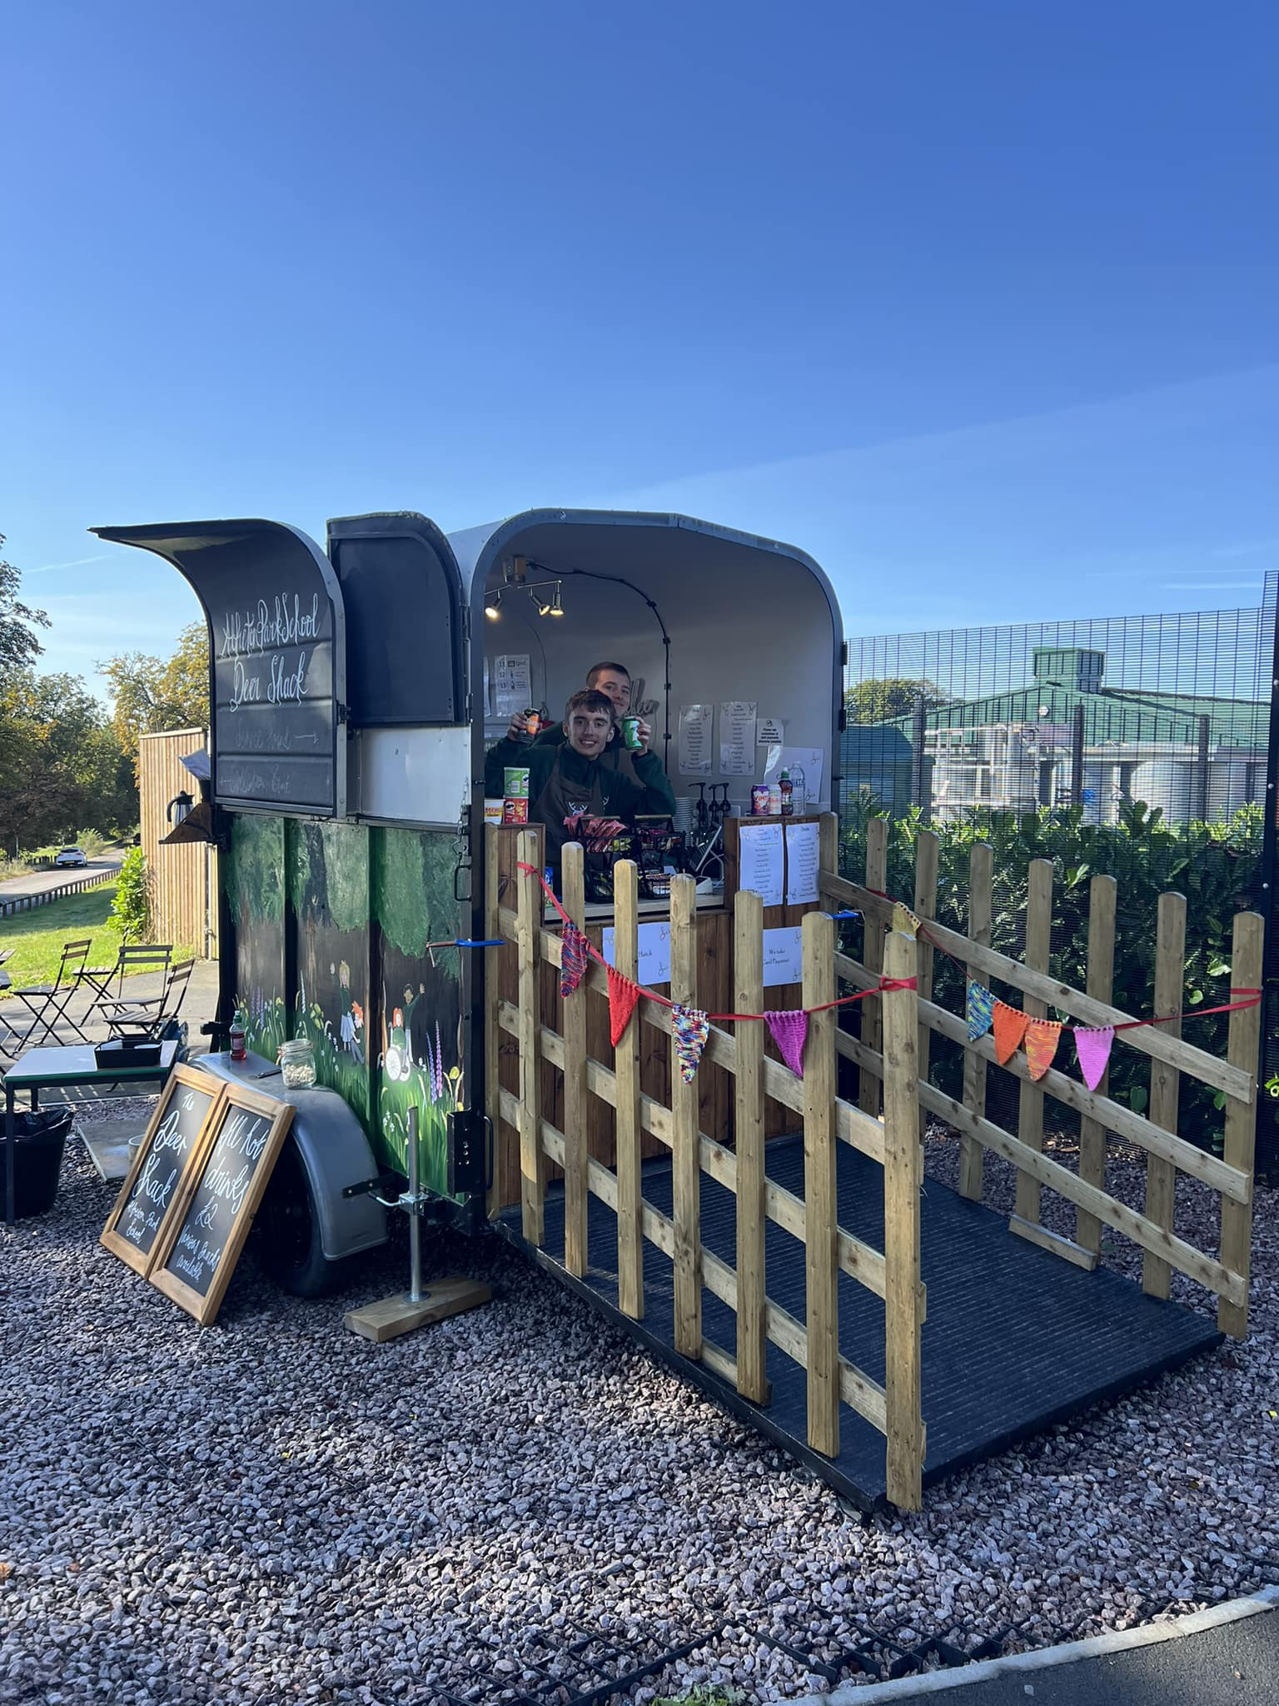
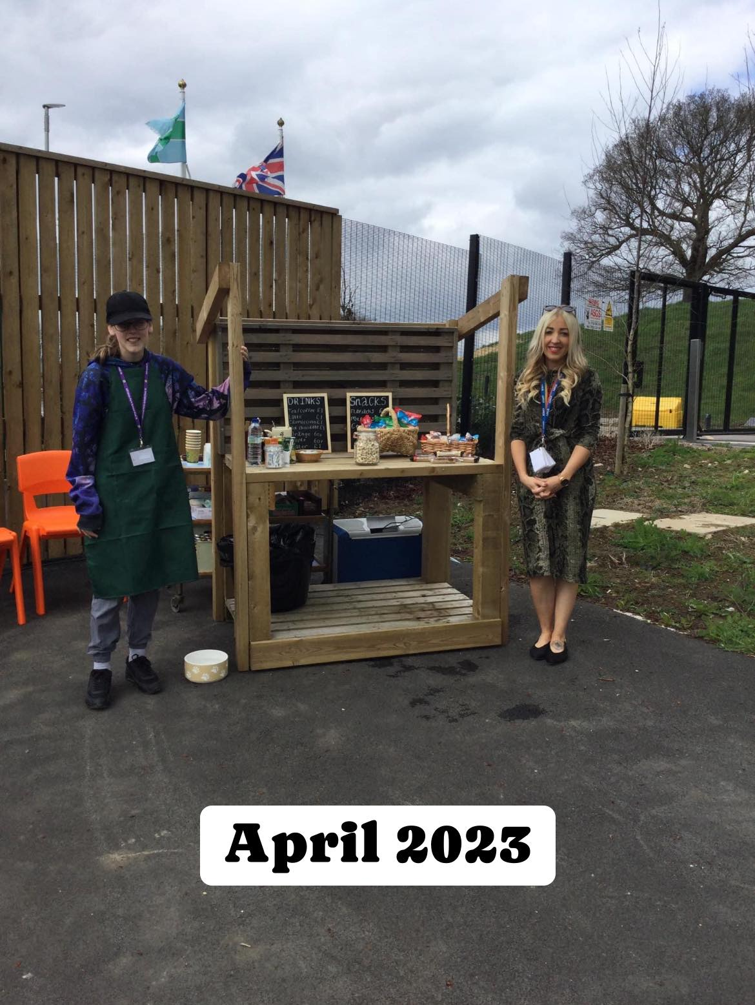
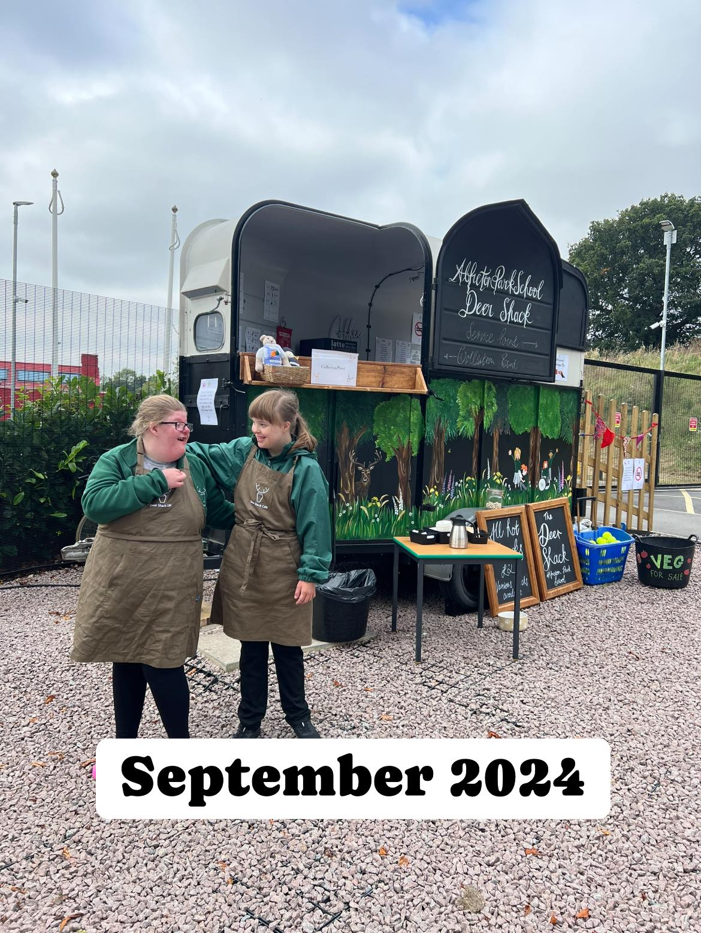

The Deer Shack

Slide 14
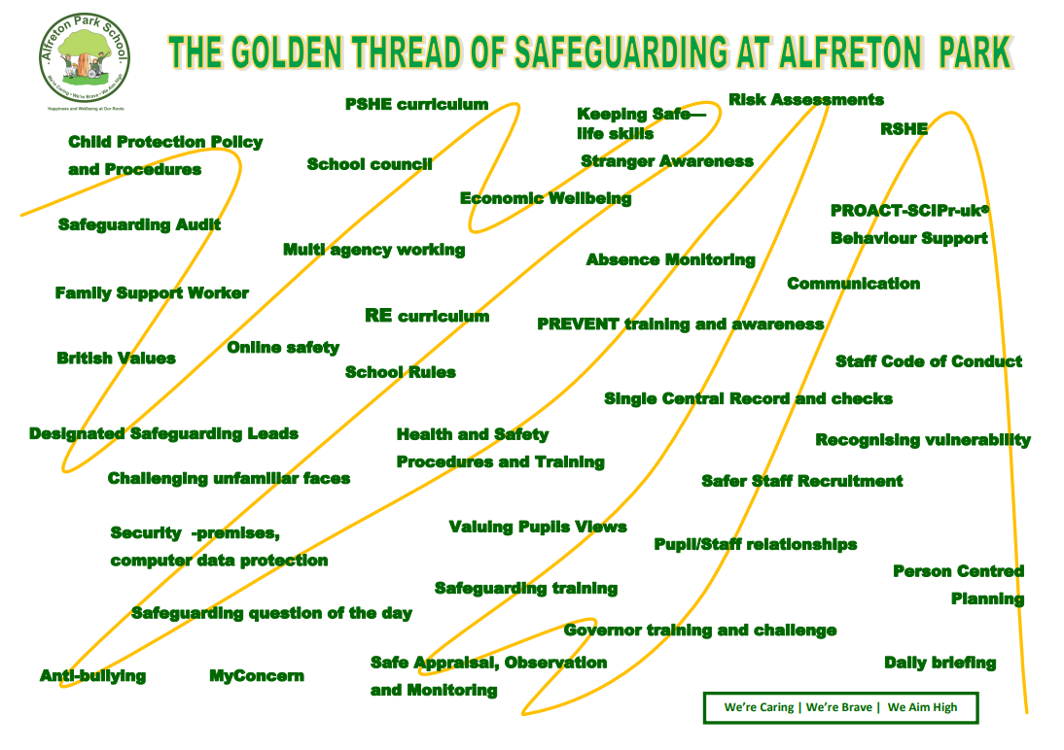

Slide 15
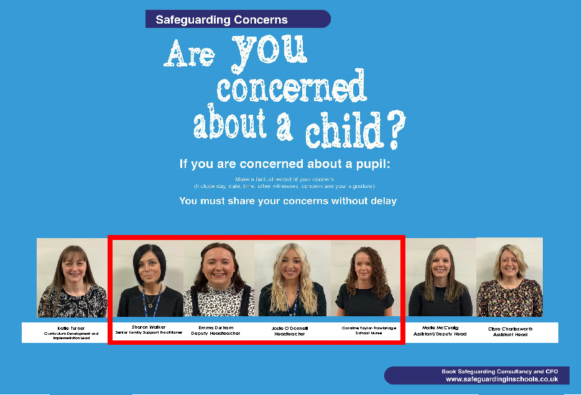
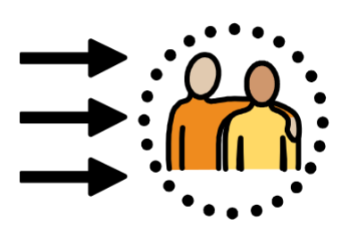
Designated Safeguarding Leads

Slide 16
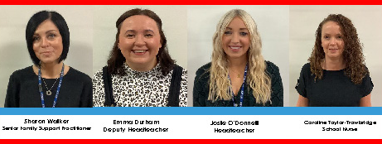
Core Safeguarding Team

Slide 17
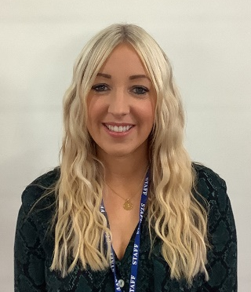
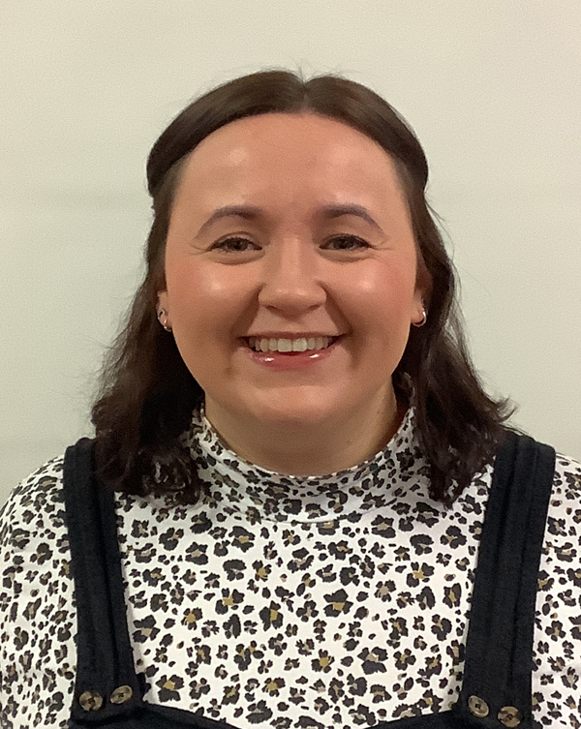
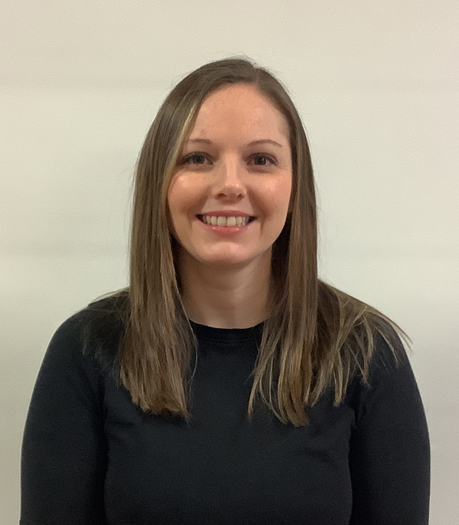
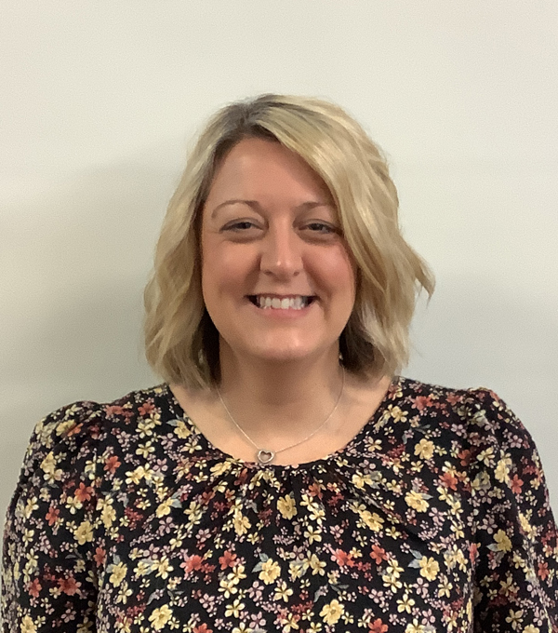
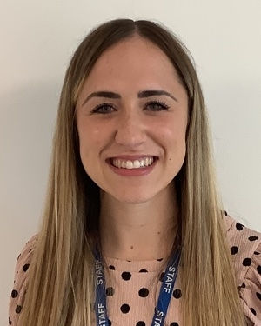
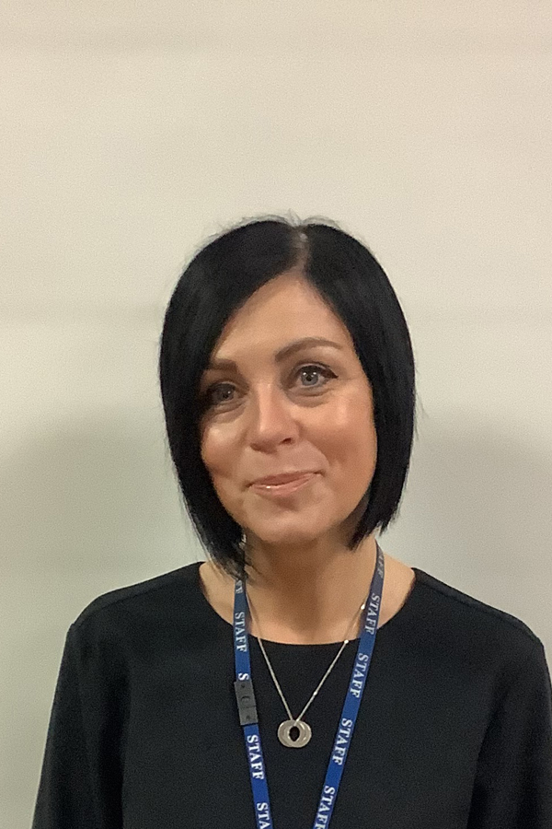
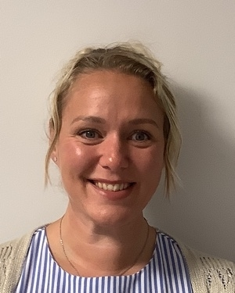
Senior Leadership Team
Josie O’Donnell
Headteacher
Emma Durham
Deputy Headteacher
Marie McCuaig
Assistant Headteacher
Clare Charlesworth
Assistant Headteacher
Leanne Squires
Assistant Headteacher
Sharon Walker
Senior Family Support Practitioner
Rebecca Dallman
School Business Manager
Kim Knowles
PA to Headteacher

Slide 18
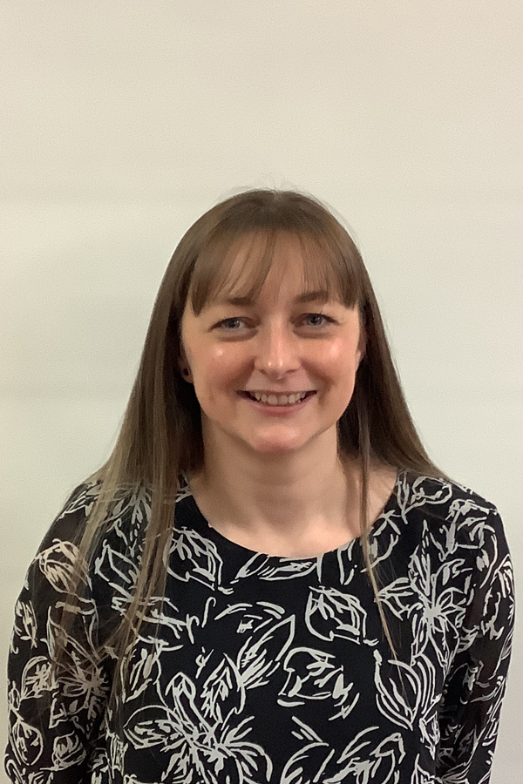
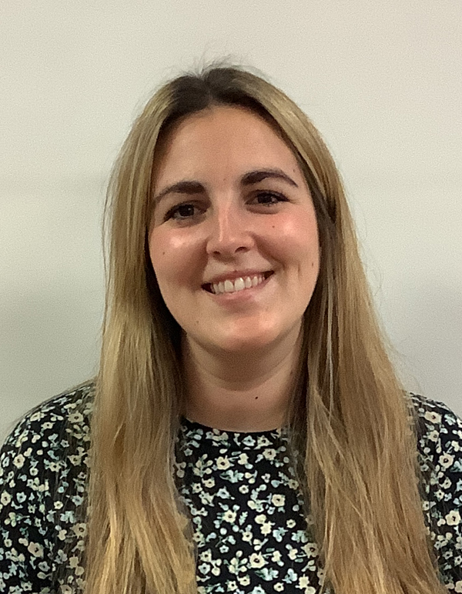
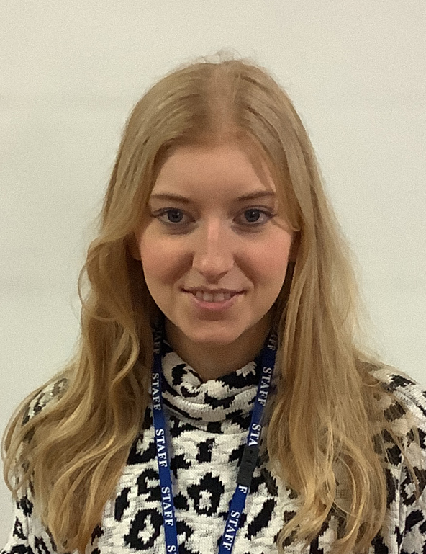
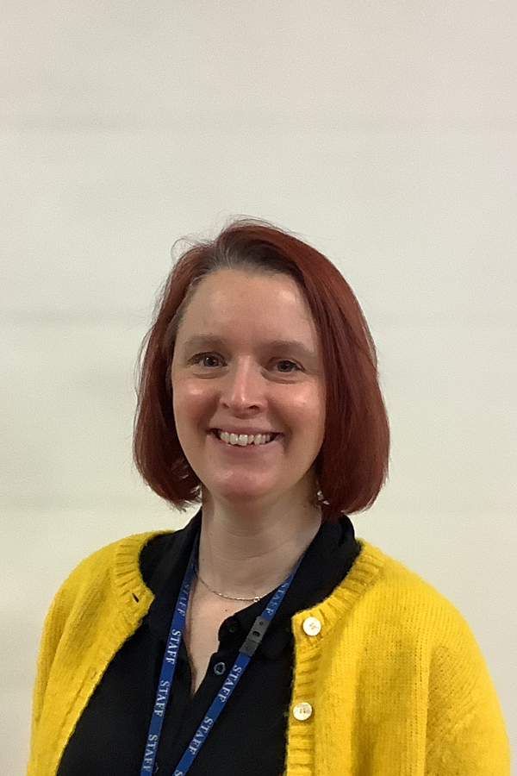
Middle Leadership Team
Katie Turner
Social, Emotional & Mental Health Lead
RSHE & PSHE
Chanise Gregory
Cognition & Learning Lead
Lucy Powell
EYFS and Nurture Lead
Amy Naylor
Post-14 Lead
Careers & Accreditation

Slide 19
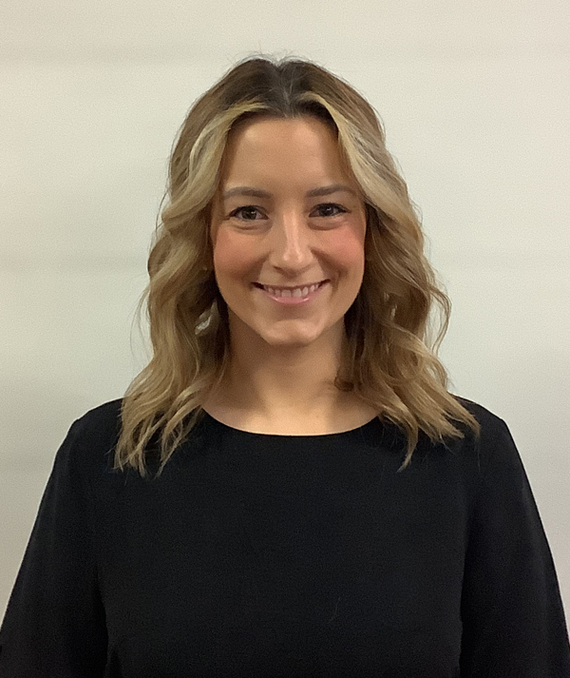










Teaching Team
Katie Henson
Katie Turner
Rebecca Larcombe
Marco Echeverria
Ruth Woodhouse
Laura James
Chanise Gregory
Annabelle Towndrow
Lucy Powell
Louise Fryer
Katy Morley
Amy Naylor
Hayley Dowson
Daniella McLachlan
Rob Baines

Slide 20




Office Team
Toyah Ridgway
Holly England
Jane Osment
Claire Fowkes

Slide 21
Family Support
Sharon Walker
Senior Family Support Practitioner

Slide 22






Physical Therapy Link Team
Donna Allsop
Lead Therapy Link Worker
MOVE Practitioner
Moving and Handling Lead
Rebound Therapy
Joe Harrison
Hydrotherapy Pool Manager
Wendy Toft
Therapy Link Worker
Rebound Therapy
Tracy Hobson
Therapy Link Worker
Christine Frost
MOVE Practitioner
Therapy Link Worker
Michelle James
Rebound Therapy
Lifeguard

Slide 23



Work Experience Team
Jeanette Scarfe
Mary Mather
Richard Simpson

Slide 24





Well-being and Nurture Team
Matt Clemens
Outdoor Learning Lead
Horticulture
Ed Acons
Music & Drama Lead
Treg Marsh
Art Mentor
Thrive Practitioner
Sam Butlin
Forest Schools and Therapeutic Forest Schools Lead
Lesley Burton
Forest Schools and Therapeutic Forest Schools Lead
Wendy Toft
Forest Schools and Therapeutic Forest Schools Lead

Slide 25
Behaviour Support Team
Josie O’Donnell
Emma Durham
Behaviour Team Lead
Sam Butlin
Katy Morley

Slide 26


Catering Team
Yssy Neild
Sam Bradshaw

